Slide 1
Interstitial Medicine Seeing the Whole Elephant
Glenn Treisman MD PhD
Eugene Meyer III Professor of Psychiatry and Medicine
Johns Hopkins University School of Medicine

Slide 2
Disclosure
I have no financial conflicts of interest regarding this presentation.

Slide 3
Objectives
Describe the way that medical silos have created barriers to holistic care
Describe sensory modulation
Discuss a group of patients who have dysautonomia and who are exemplars of why we need interdisciplinary medical care

Slide 4
Holistic understanding of medicine
Everything in the human body has an effect on everything else.
The division between medical illness and psychiatric illness is an illusion.
Medicine has created “silos” that are barriers to a holistic view.
Patients who fall into the space between the walls of specialties need “interstitial” care provided in true interdisciplinary clinics

Slide 5
Introduction
We tend to see the world through the lens of our specialty.
Medicine has become highly specialized creating “silos” and limiting the view of patients who are atypical, co-morbid or difficult.
The division between medical illness and psychiatric illness is an illusion.
Everything in the human body has an effect on everything else.
There are patients who fall between the walls that separate infectious disease, gastroenterology, rheumatology, neurology, psychiatry and all other specialties. These patients need “interstitial” care.

Slide 6
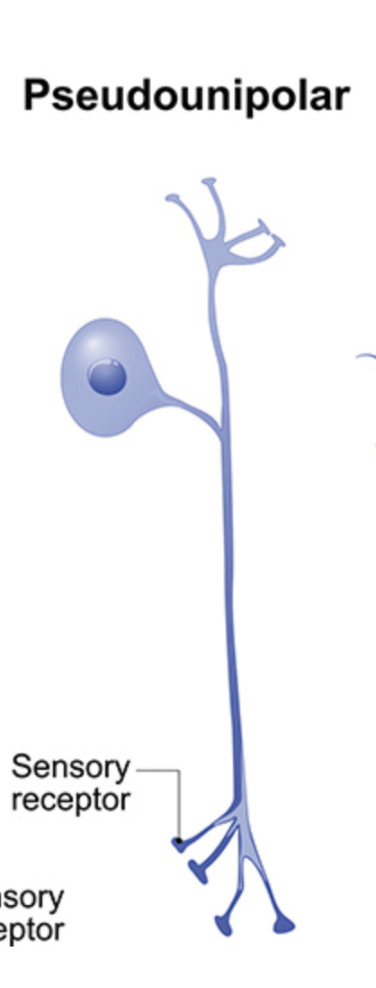
Sensory Neuron
Acute pain vs Chronic Pain
Is chronic pain “psychosomatic”?
Voltage gated sodium channels result
In depolarization

Slide 7
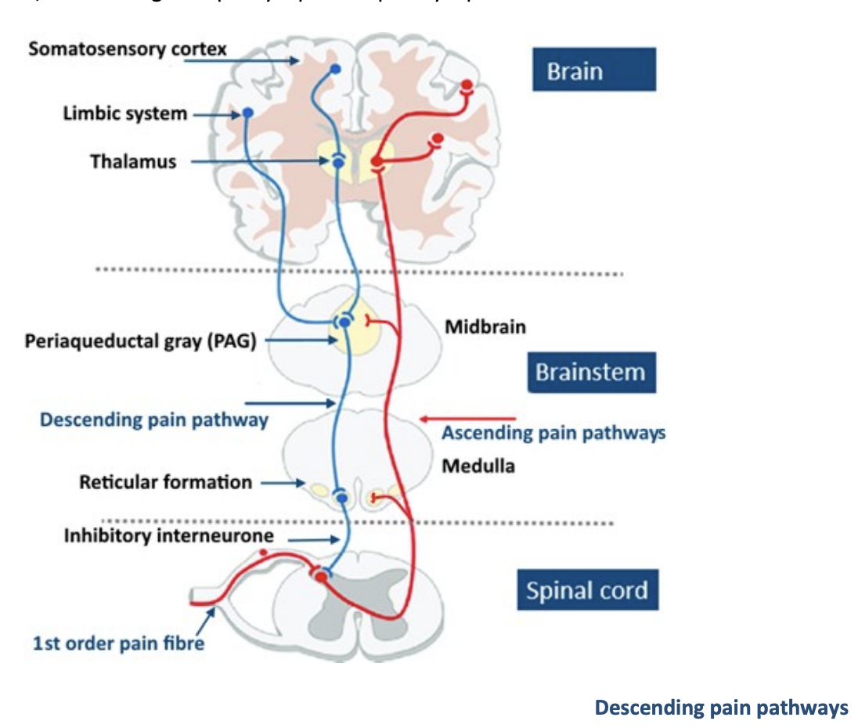
Both acute pain and chronic
pain are modulated
Both the somatosensory and
autonomic nervous system
convey pain information

Slide 8
A group of ”chronic pain patients” with remarkable co-morbidity
Depression
Chronic pain
Migraine
GI dysmotility
IBS
Ehlers-Danlos
Sympathetic pain
Sensory amplification (tinnitus)
Chronic Fatigue
Fibromyalgia
POTS
Tachycardia
Chronic chest pain
Mixed connective tissue disease
Brain fog (cognitive impairment)
Lyme disease
“Long Covid”

Slide 9
These patients are often labeled as “functional’
What do we mean by functional? (usually we mean not real)
A disorder in which the physical symptoms have a psychological function in the patient-psychosomatic
Something the patient is doing
A disorder of function rather than structure (the newer use of the term)

Slide 10
There are psychosomatic illnesses
Malingering
Conversion
Pseudoseizures

Slide 11
Malingering
47 year old man came to the ER for abdominal pain which was severe and intolerable. He was extremely demanding and agitated, wanting narcotics (dilaudid by name) and saying he needed to be in the hospital. The name, address, and insurance info he gave matched a patient in the system who was 24 years old. The consulting psychiatrist called the home phone number in the chart and his son told us that the patient had given us his information, that he had been ejected from his son’s home, and that the police were searching for him for some other issue. His son pointed out that he would not be responsible for the hospital bill.

Slide 12
Functional disorder (Pseudoseizures)
A 34 year old woman admitted to the pain service after her seizures were found to be non-epileptiform on EEG. She had recently discovered her daughter was pregnant, had limited resources at home, and had limited financial resources. Her “spells” stopped gradually over a couple of days with supportive therapy and family meetings.

Slide 13
Conversion
19 year old college student seen for paralysis of her right hand at the wrist in a way that did not follow muscle or nerve distributions. Her hand was somewhat pale and cold to the touch in contrast to her other hand. The psychiatric consultant found she was a religious Catholic and had been dating a popular athlete who was pressuring her to have premarital sex. The function gradually returned to her hand as she discussed her guilt and shame about her behavior at the most recent encounter with him. She was reassured by some education and support and was satisfied with our arranging counselling at her church.

Slide 14
Website of Richard Boles

Slide 15
Dysautonomia (dysregulation of the autonomic nervous system) has been linked to all these conditions in the literature
POTS/NMH
Migraine
Brain fog
Gut dysmotility
IBS
Fibromyalgia
MCTD
Chronic Fatigue
Tinnitus
Interstitial cystitis
Chronic pain
CRPS/RSD
Depression
Ehlers-Danlos
Lyme disease
Long Covid

Slide 16
Sodium "Channelopathy”
Major Depression
(bipolar disorder)
Familial Dysautonomia
Migraine
Tinnitus
Vestibular dysfunction
Familial Immune
Dysregulation
Ehlers Danlos
Trauma
Chronic Pain
CRPS
Central Pain
Small fiber neuropathy
Fibromyalgia
CFS
Autonomic
Dysfunction
(neuropathy)
Immune dysregulation
Post Covid
Post Lyme
GI Dysbiosis
Post Mono
Post Gastroenteritis
Infectious Insult
Lyme
COVID
Mono
Gastroenteritis
Gi Dysmotility
Chronic abdominal pain
Dysmotility
IBS
Hyperhydrosis
POTS
NMH

Slide 17
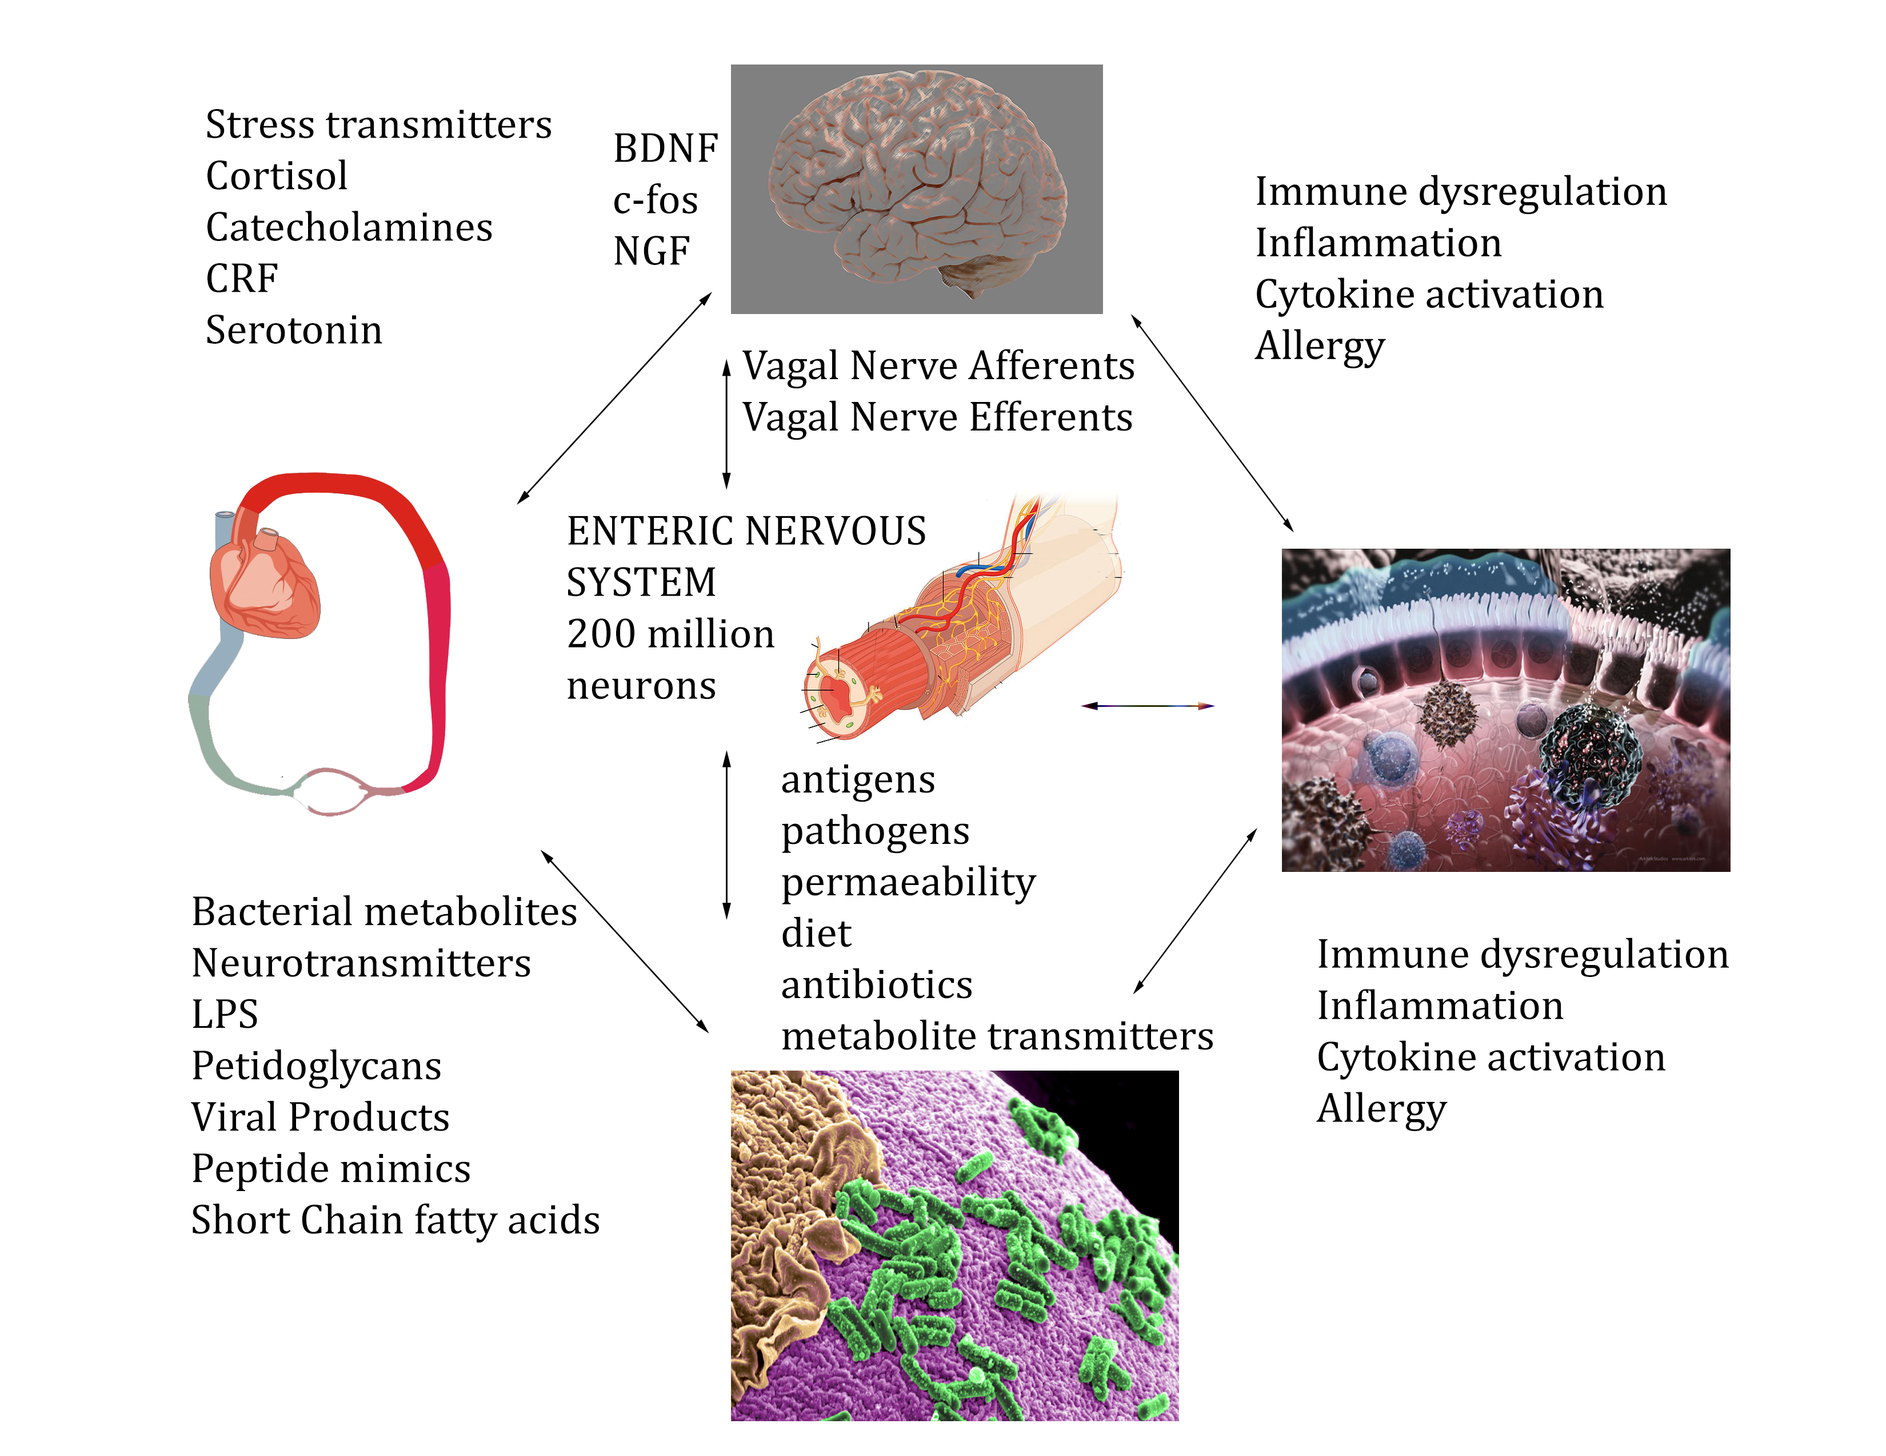

Slide 18
Because of “medical silos” appreciation of dysautonomia is often missed
POTS/NMH Cardiology
Migraine Neurology
Brain fog Neurology
Gut dysmotility GI
IBS GI
Fibromyalgia Rheumatology
MCTD Rheumatology
Chronic Fatigue Inf Disease
Tinnitus ENT
Interstitial cystitis Urology
Chronic pain Anesthesia
CRPS/RSD Anesthesia
Depression Psychiatry
Ehlers-Danlos PMR
Lyme Inf Disease
Long COVID ?

Slide 19
Increasing Interest in Dysautonomia
Before the year 2000 there were 7350 papers on google scholar
Between 2000 in 2021 there were 21,300 papers
There are many descriptions of acquired dysautonomia
Many speculations on infectious/autoimmune/genetic causes

Slide 20
Central Dopamine dysfunction
Stress axis activation
Anxiety
Depression
Anhedonia
Increased pain transmission
Hopelessness
Insomnia
Hebetude/Apathy
Deconditioning
Autonomic dysfunction
Chronic sympathetic activation
Hyperhidrosis
Tachycardia
Skin changes
Intense fatigue
Increased pain sensitivity
Sensation of stress/anxiety
Complex Regional Pain
Chronic parasympathetic inhibition
GI dysmotility
Chronic constipation
POTS
Insomnia
Chronic Immune Activation
Dysbiosis
Bacterial translocation
Vulnerability to infection
Increase pain transmission
Chronic Inflammation
End organ damage
Increased cytokine levels
Stress axis activation
diminished resilience

Slide 21
Patient with “functional GI disorder”
22 year old female with Fibromyalgia, POTS, TMJ syndrome, IBS with alternating diarrhea and constipation, migraine headaches with multiple food triggers, dysmenorrhea, chronic abdominal pain, back pain and depression on 6-8 mg of clonazepam a day. Intolerant of all psychotropic drugs
GI workup shows slowed colonic transit
Tilt table shows moderate to severe POTS.
ANA pos to 640 but no clear diagnostic antibodies
Exposure to antidepressants demonstrated Bipolar II
Developed ITP on VPA and responded to steroids with a mixed state

Slide 22
Med list failed meds current meds
Aripiprazole
Buspirone
Doxycycline
Escitalopram
Midodrine
Nortriptyline
Fludrocortisone
Gabapentin
Pregabalin
Doxepin
Dicyclomine
Guanfacine
Hyoscyamine
Iloperidone
Liothyronine
Naltrexone
Pramipexole
Propranolol
Pyridostigmine
Quetiapine
Risperidone
Vortioxetine
Vilazodone
Venlafaxine
Ziprasidone
desvenalfaxine
Protriptyline 30
Lamotrigine 300 mg
Lithium 750
Cariprazine 6
Asenapine 5
Topiramate 150/ 150
Vpa 250/500
Pendulum probiotic

Slide 23
Autonomic nervous
system imbalance
Physical deconditioning
Dopamine dysfunction
Cognitive impairment
Constipation
Poor sleep
Sympathetic over activation
Injury
Infection
Genetics
Stress
Dysbiosis
CNS sensitization pain amplification
Chronic fatigue
Immune system over activation
Autoimmune disease
Excessive use of narcotics
Fibromyalgia pain
Chronic inflammation
Narcotic induced gut dysmotility
Pain amplification
Nerve injury
Disability
Parasympathetic inhibition
Conflicting diagnoses
Migraine
Hyperhydrosis
Deconditioning
Leaky gut
Neuropathic pain
Inability to get better
Immune activation
Behavioral conditioning “rewards” illness

Slide 24
Autonomic nervous
system imbalance
Physical deconditioning
Dopamine dysfunction
Cognitive impairment
Constipation
Poor sleep
Sympathetic over activation
Injury
Infection
Genetics
Stress
Dysbiosis
CNS sensitization pain amplification
Chronic fatigue
Immune system over activation
Autoimmune disease
Excessive use of narcotics
Fibromyalgia pain
Chronic inflammation
Narcotic induced gut dysmotility
Pain amplification
Nerve injury
Disability
Nerve injury
Parasympathetic inhibition
Conflicting diagnoses
Migraine
Migraine
Hyperhydrosis
Deconditioning
Leaky gut
Neuropathic pain
Leaky gut
Inability to get better
Immune activation
Behavioral conditioning “rewards” illness

Slide 25
Autonomic nervous
system imbalance
Physical deconditioning
Dopamine dysfunction
Cognitive impairment
Constipation
Poor sleep
Sympathetic over activation
Injury
Infection
Genetics
Stress
Dysbiosis
CNS sensitization pain amplification
Chronic fatigue
Immune system over activation
Autoimmune disease
Excessive use of narcotics
Fibromyalgia pain
Chronic inflammation
Narcotic induced gut dysmotility
Pain amplification
Nerve injury
Disability
Parasympathetic inhibition
Conflicting diagnoses
Migraine
Hyperhydrosis
Deconditioning
Leaky gut
Neuropathic pain
Inability to get better
Immune activation
Behavioral conditioning “rewards” illness

Slide 26
Autonomic nervous
system imbalance
Physical deconditioning
Dopamine dysfunction
Cognitive impairment
Constipation
Poor sleep
Sympathetic over activation
Injury
Infection
Genetics
Stress
Dysbiosis
CNS sensitization pain amplification
Chronic fatigue
Immune system over activation
Autoimmune disease
Excessive use of narcotics
Fibromyalgia pain
Chronic inflammation
Narcotic induced gut dysmotility
Pain amplification
Nerve injury
Disability
Parasympathetic inhibition
Conflicting diagnoses
Migraine
Hyperhydrosis
Deconditioning
Leaky gut
Neuropathic pain
Inability to get better
Immune activation
Behavioral conditioning “rewards” illness

Slide 27
Da Costa’s Syndrome (1871) (soldier’s heart) (originally thought to be cardiac but reclassified as hysteria)
Often developed after a bout of fever or diarrhoea
The pulse was always greatly and rapidly influenced by position
Chest pains
Palpitations
Breathlessness
Fatigue in response to exertion
Used digitalis (sodium-potassium ATPase inhibitor)
Called "irritable heart” by Da Costa who studied 300 cases
The classic case soldiers had trouble keeping up

Slide 28
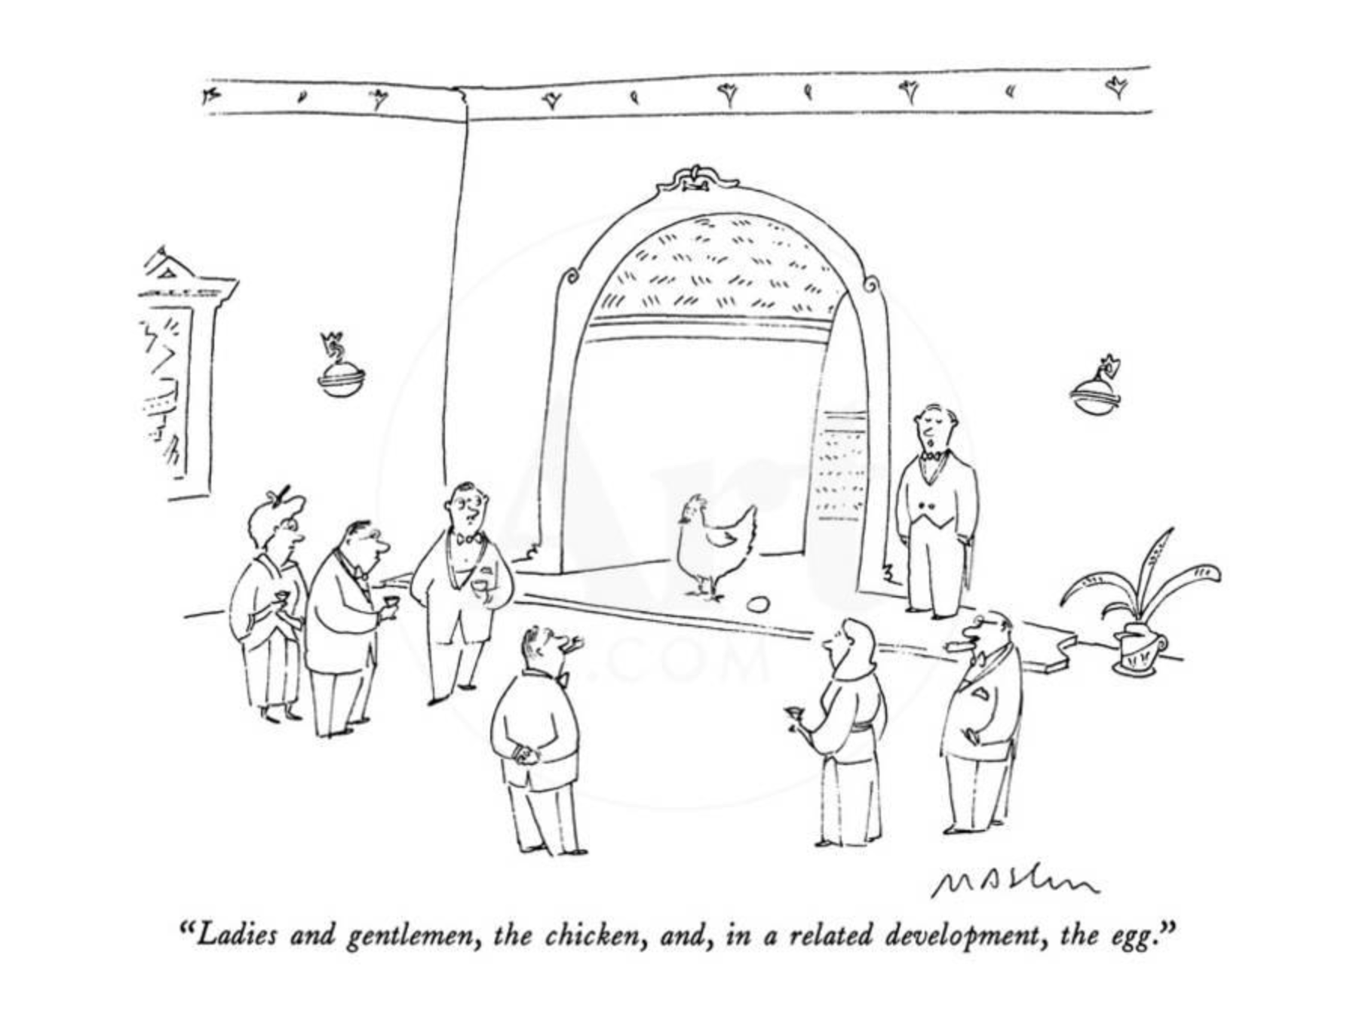
Which came first? The psychiatric condition or the medical condition?

Slide 29
What ties together “…all these things wrong with me?”
Possibly a neuropathic injury to nerves including:
Chronic pain
Loss of GI function
Loss of adequate surveillance of body systems and therefore inadequate responses (POTS/NMH/dysmotility/abnormal sensations/chronic nausea/hyperhidrosis/dyshydrosis/temperature dysregulation/immune dysregulation/abnormal bladder and bowel sensations/abnormal blood vessel responses to O2 tension (migraine)

Slide 30
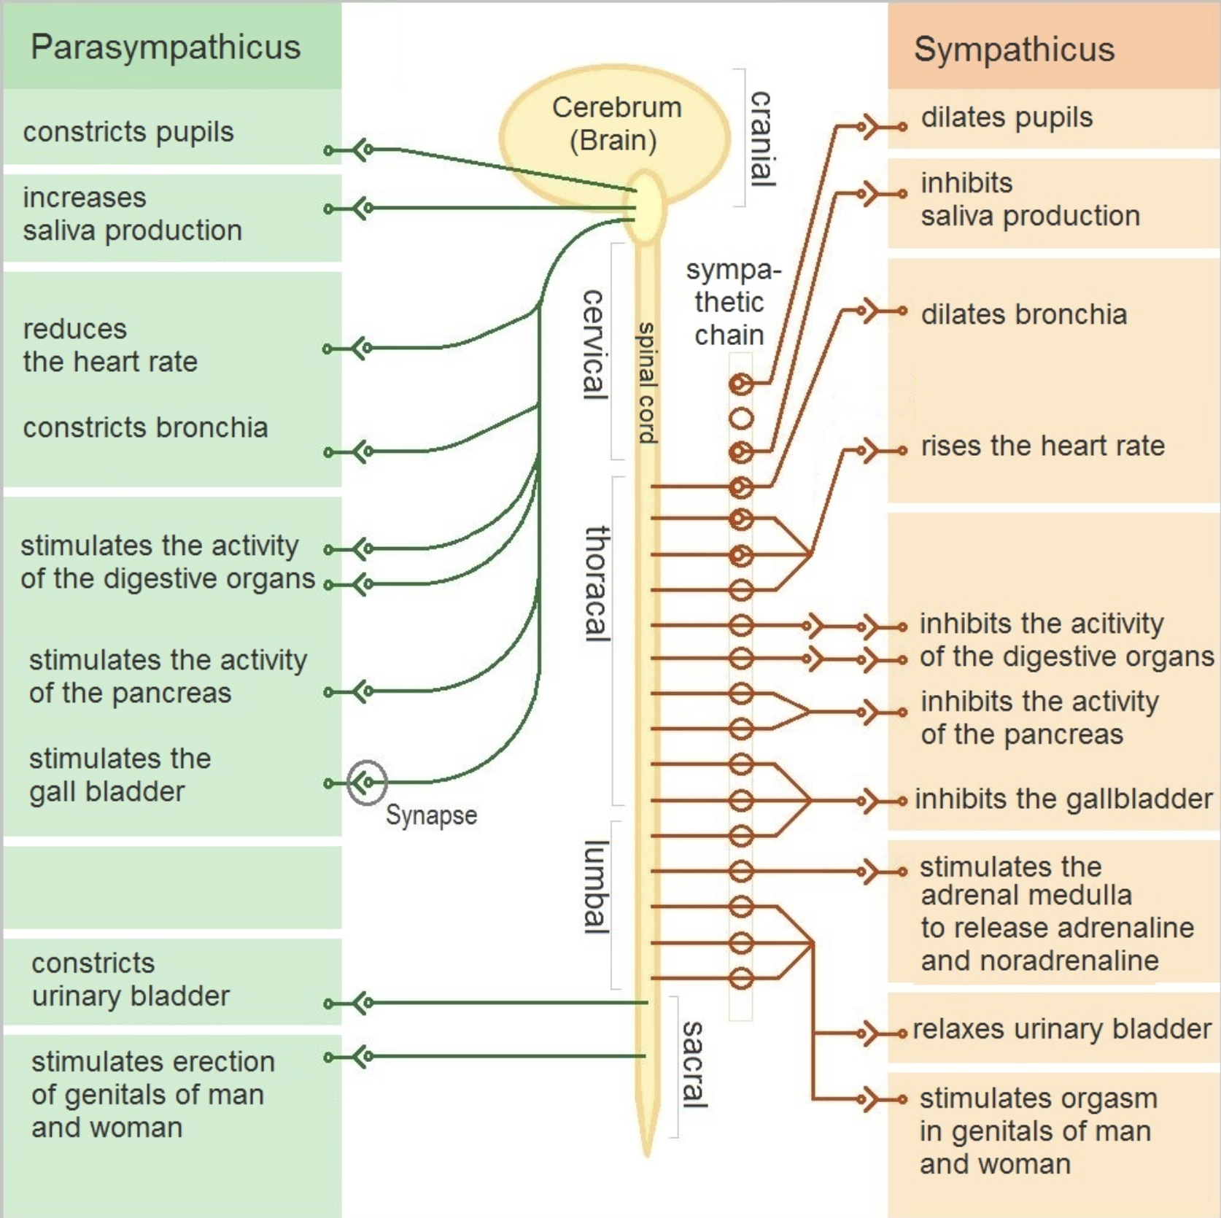
Autonomic Nervous System
Sympathetic “fight or flight”
Parasympathetic-relax and digest

Slide 31
Autonomic Nervous system
Damaged Afferents
The body cannot sense what is happening
Damaged Efferents
The body has trouble responding to input
Pain (often referred)
Oxygen tension
CO2 tension
Blood pressure
Temperature
Blood toxins
Lung distension
GI chemical content
GI distension
Visceral stretch
Bladder fullness
Sexual information
Pupil size
Lacrimation
Salivation
GI secretion
GI motility
Heart rate
Blood pressure
Sweating
Shivering
Vasodilation
Pulmonary resistance
Urination
Defecation
Sexual function

Slide 32
Dysautonomia-Key questions
Who gets it?
Genetic and environmental vulnerabilities
Why do they get it?
Precipitating causes
What is the pathological mechanism for the syndrome?
Neuropathic injury
Immune dysregulation
Dysbiosis?
CNS stress axis and dopamine system?
What are the factors that determine who gets what symptoms?

Slide 33
Putative causes of dysautonomia
Abnormal immune activation
Dysbiosis
“Leaky gut” (bacterial translocation)
Food allergy (gluten enteropathy)
Sodium channel-opathy
Calcium channel-opathy
Mitochondrial disease
Metabolic disease

Slide 34
JAG-A syndrome described by Jay Pasricha
Joint hypermobility or any type of connective tissue disease, such as Ehlers-Danlos syndrome
Autonomic dysfunction such as postural orthostatic tachycardia syndrome, or POTS, which involves an abnormal heart rate increase upon standing
Gastrointestinal dysmotility such as gastroparesis or slow-transit constipation
Autoimmunity or predisposition to any underlying autoimmune disease
“Describing the JAG-A syndrome and the criteria by which a patient may fit into the group has helped us identify patients who may have an underlying autoimmune problem that is contributing to or causing their motility disorder,”

Slide 35
Of approximately 500 patients seen for pain/dysmotility/weight loss/nausea/vomiting
About 90 % have evidence of abnormal GI function
About 85 % have depression by clinical examination
About 3/4 have other autonomic issues
About half have hypermobile joints (EDS or spectrum)
About 1/3 have clear evidence of autoimmunity
About 2/3 have a family history of a related condition (GI/dysautonomia/autoimmune)
Of those with clear autoimmunity we have given IVIG to about 30 patients with 10 “miracle” resolutions of nearly all their symptoms and 15 patients with significant benefit

Slide 36
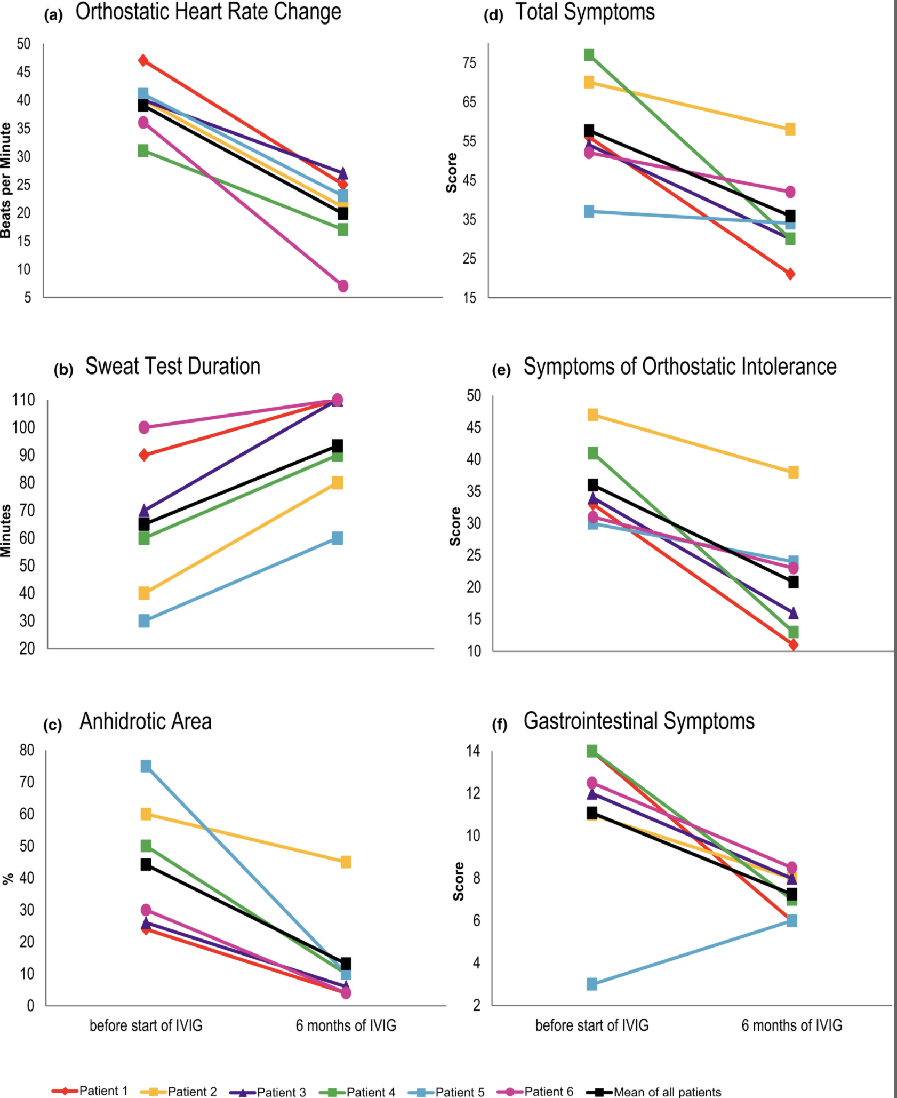
IVIG treatment in a series of 6 cases of presumed
autoimmune dysautonomia
Rodriguez B., Hoepner R., Salmen A., Kamber N., Z’Graggen W.J. Immunomodulatory treatment in postural tachycardia syndrome: A case series European Journal of Neurology. 2021. 28(5), pp. 1692-1697

Slide 37
43 y.o. patient with anxiety and hyperhidrosis
On evaluation he had multiple autonomic dysfunctions
On genetic testing he had a sodium channel gain of function NAV 1.8 mutation
Our group cloned the sodium channel gene into a mouse and made both heterozygous and homozygous mutants

Slide 38
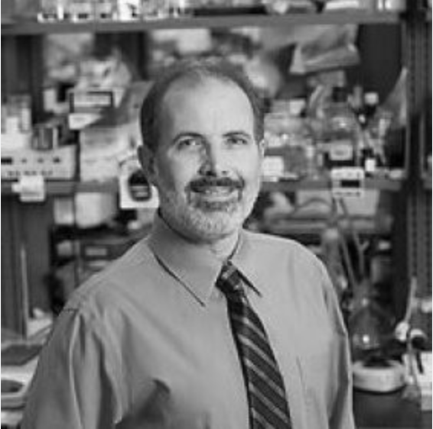
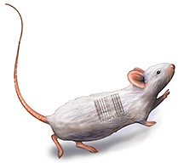
Nav1.8 - mutations
Roger Reeves, aka Mighty Mouse
Chip Hawkins
Malcolm Brock
Notes:
At the Johns Hopkins Transgenic Core Laboratory, they used CRISPR technology to produce a gain-of-function mutation in SCN10A (Nav1.8).

Slide 39
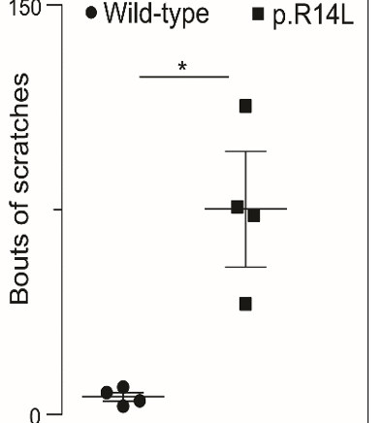
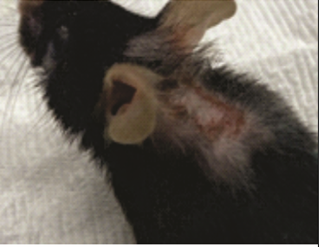
Neuropathic Itch
Mutant
Notes:
Single housed male mouse with scratching due to gain of function mutation in Nav 1.8.

Slide 41
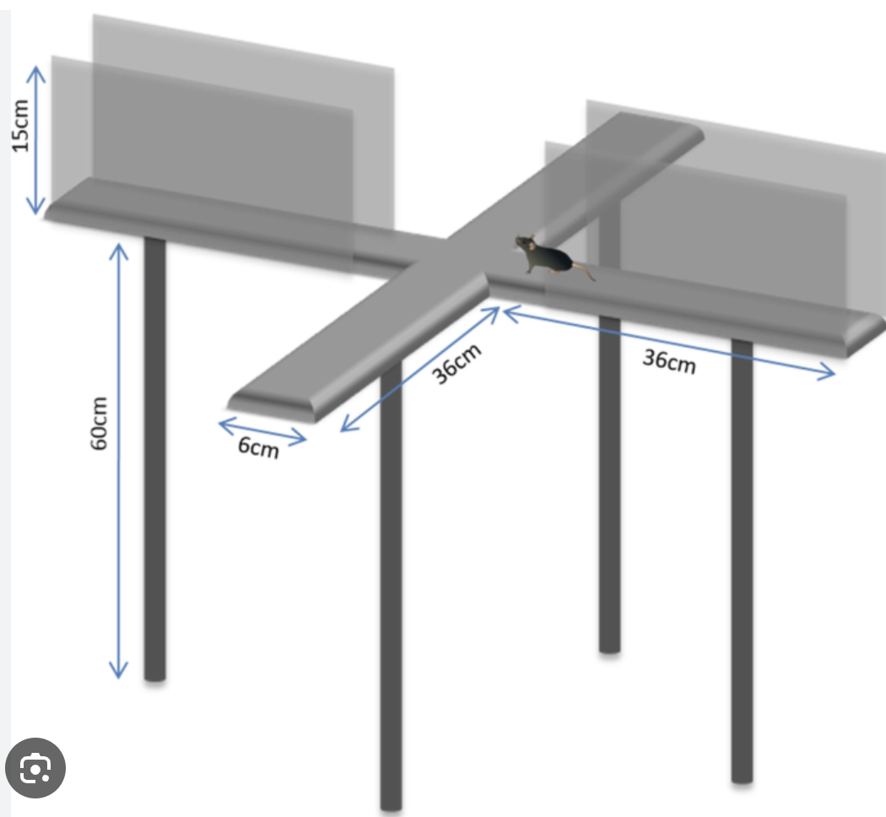
Elevated plus maze for depression and anxiety testing

Slide 42
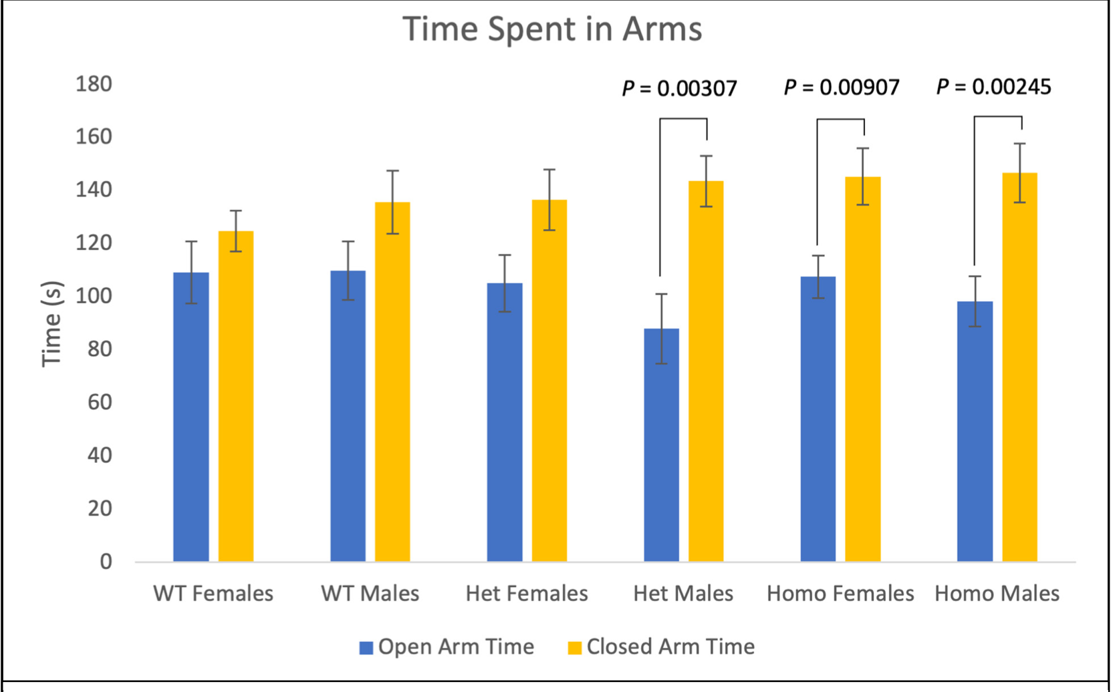
Nav1.8 – Behavior - EPM
Notes:
Mice were C57bl/6J background mice – males and females. N=75 mice or n>12 mice in each group. Heterozygous and homozygous mice spent significantly more time in the closed arms than the open arms.

Slide 43
Rational Therapeutics
All treatments have potential risks and benefits
All medical conditions have risks if not treated
The goal of rational therapeutics is to provide the best possible risk/benefit ratio

Slide 44
What does treatment look like for the complex patient with multiple medical issues?
Try to come up with a diagnostic formulation (hypothesis)
Trial and error (Lots of errors-do the errors inform the formulation?)
Ideally-a cure
Rehabilitation (physical, social, psychological)
Pharmacological goals:
Reduction of pathological process
Reverse associated conditions
Behavioral Goals:
Quality of life
Longevity
Function

Slide 45
Work-up (these argue against a purely psychiatric formulation)
Small fiber neuropathy
Abnormal GI transit
Abnormal neurological examination
Abnormal nerve conduction studies
Abnormal tilt table test
Positive immune serology
Chronic inflammation
Abnormal endocrine tests

Slide 46
My fundamental hypothesis for these patients- Damaged nerves produce aberrant signals
Try to improve the ”signal to noise ratio”
Membrane stabilizers
Physical activation
Try to down-regulate amplifiers of signaling
Decrease sympathetic activation
Treat depression
Diminish focus on noxious sensation
Try to mitigate the nerve damaging process
Immunomodulators
Improve diet
Treat inflammatory provocation

Slide 47
Pharmacology for dysautonomia (and how I think they might work)
Neuromodulators
Drugs that downregulate sympathetic tone (TCA’s, SNRI’s, Alpha 2 agonists, B-blockers, mirtazapine)
Drugs that decrease neuronal excitability (anticonvulsants, calcium channel blockers, antiarrhythmics)
Drugs that improve dopamine function (TCA’s, SNRI’s, mirtazapine, atypical neuroleptics)
Drugs that improve parasympathetic activity (cholinergic agonists, acetylcholinesterase inhibitors)
Immunomodulators
Biologics
Immuno-inhibitors
Steroids
Non-steroidal anti-inflammatories

Slide 48
Pharmacology for dysautonomia (and how I think they might work)
Neuromodulators
Drugs that downregulate sympathetic tone (TCA’s, SNRI’s, Alpha 2 agonists, B-blockers, mirtazapine)
Drugs that decrease neuronal excitability (anticonvulsants, calcium channel blockers, antiarrhythmics)
Drugs that improve dopamine function (TCA’s, SNRI’s, mirtazapine, atypical neuroleptics)
Drugs that improve parasympathetic activity (cholinergic agonists, acetylcholinesterase inhibitors)
Immunomodulators
Biologics
Immuno-inhibitors
Steroids
Non-steroidal anti-inflammatories
Symptomatic treatment for
Migraine
GI motility
Nausea
Orthostasis
Depression

Slide 49
Neuromodulators for neuropathic dysautonomia
Drug | NE reuptake | 5HT reuptake | DA reuptake | Gastric emptying | Sleep | Constipation Dry mouth | Orthostasis | Membrane stabilizer | Cardiac | Weight | Pain
Nortriptyline | ++++ | ++++ | - | +/- | +++ | ++ | + | Y | ++ | ++ | Y
Protriptyline | ++++ | ++++ | - | + | +/- | + | + | Y | ++ | +/- | Y
Doxepin | ++++ | ++++ | - | +/- | ++++ | + | ++ | Y | ++ | ++ | Y
Venlafaxine | ++ | ++++ | - | +++ | - | - | - | N | N | - | Y
Duloxetine | ++ | ++++ | +/- | ++ | - | - | - | N | N | - | Y
Mirtazapine | - | - | - | ? | ++++ | +/- | - | N | N | ++++ | Y
Sertraline | - | ++++ | - | +++ | - | - | - | N | N | - | N

Slide 50
Neuromodulators for neuropathic dysautonomia
Drug | Mechanism | Probably helps with | Biggest issue
Lamotrigine | Membrane stabilizing | Autonomic neuropathy | Slow titration and rash
Topiramate | Unknown | Autonomic neuropathy | Cognitive impairment
Gabapentin | Voltage gated Ca channel α2δ Subunit | Autonomic neuropathy | Modest efficacy alone
Pregabalin | Voltage gated Ca channel α2δ Subunit | Autonomic neuropathy | Modest efficacy alone
Valproic acid | Membrane stabilizing | Autonomic neuropathy | Weight gain and toxicity
Carbamazepine | Membrane stabilizing | Autonomic neuropathy | Sedation
Verapamil | Calcium channel blocker | Unclear | Constipation decreased BP
Clonidine? | Alpha 2 adrenergic agonist | Sympathetic modulation | Orthostasis
Olanzapine | Unclear to me | Amplifying other drugs | Weight gain
Cannabinoids?

Slide 51
Essential information for patients
You have a real disease
Your tissue is not being injured when you feel pain
Depression is a disease
Anti-depressants reduce pain and help your other symptoms even if you do not have depression (which you have)
Physical activation will help improve the signal to noise ratio as much as the medicine

Slide 52
Conclusions
Everything in the human body has an effect on everything else.
The division between medical illness and psychiatric illness is an illusion.
Medicine has created “silos” that are barriers to a holistic view.
We are the experts at what is and what is not a psychiatric disorder
Patients who fall into the space between the walls of specialties need “interstitial” care provided in true interdisciplinary clinics.

Slide 53
Be a therapeutic optimist
Never, never, never, never, never give up
Winston Churchill

Slide 54
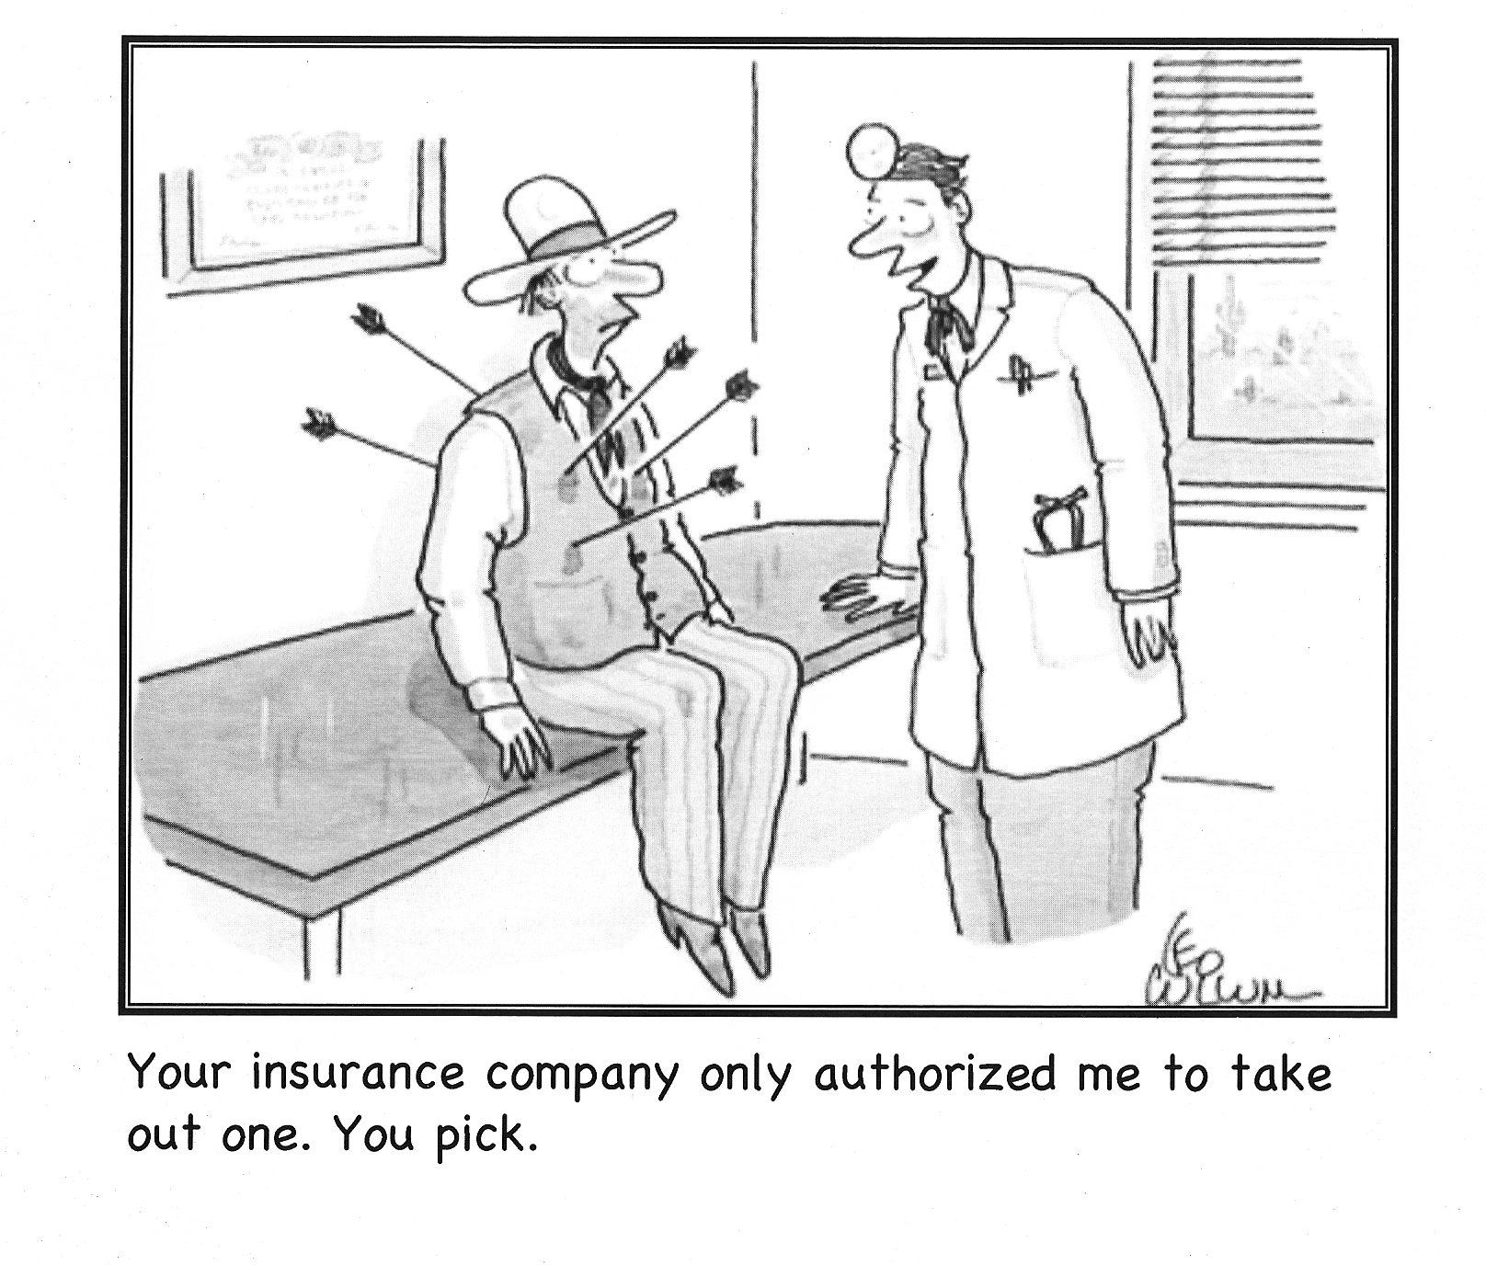

Slide 55
END Here

Slide 58
Hypochondriasis
Preoccupation with
possible illness
Pain amplification
Increased pain sensation due
to nervous system adaptation
Conversion
Neurologic symptom caused by a psychological problem
Symptom Exaggeration
Symptoms are over-expressed
Somatization
Physical symptoms caused
by psychological distress
Unexplained medical symptoms
Medical symptoms that have no current pathology
Conditioned Illness Behavior
Symptoms that are “conditioned” by
classical or operant paradigms
Malingering
Symptoms are feigned to obtain a goal

Slide 59
Premorbid
vulnerability
Inciting event
Symptom cluster
Medical system response
Headache
Multiple workups
Chronic constipation
Fatigue
Numerous non-diagnostic findings
Infection
Diminished function
Long list of diagnoses
Multiple Infections
Brain Fog
Trauma
Chronic pain
“Functional disorder” diagnosis
Joint dislocations
subluxations
GI dysfunction
“High cost utilizer” status
Psychiatric disorder
Psychiatric disorder
Increasing level of dysfunction
Dizziness
Family history of:
Immune issues
Autonomic issues
Fainting
Increasing identification as a “sick person”
Loss of energy
Inadequate trials and unusual treatments
Sleep disturbance
Labeled as psychosomatic

Slide 60
Central Dopamine dysfunction
Stress axis activation
Anxiety
Depression
Anhedonia
Increased pain transmission
Hopelessness
Insomnia
Hebetude/Apathy
Deconditioning
Severe stressor
Infection
Autonomic dysfunction
Chronic sympathetic activation
Hyperhydrosis
Tachycardia
Skin changes
Intense fatigue
Increased pain sensitivity
Sensation of stress/anxiety
Complex Regional Pain
Chronic parasympathetic inhibition
GI dysmotility
Chronic constipation
POTS
Insomnia
Chronic Immune Activation
Dysbiosis
Bacterial translocation
Vulnerability to infection
Increase pain transmission
Chronic Inflammation
End organ damage
Increased cytokine levels
Stress axis activation
diminished resilience
GI disorder
Immune Insult

Slide 61
Central dopamine dysregulation
Chronic stress axis activation
Depression
Fatigue
Cognitive impairment
Autonomic nervous system dysregulation
Migraine
Tinnitus
TMJ
POTS NMH
Interstitial cystitis
GI Dysmotility
IBS
Fibromyalgia
Dysbiosis
Bacterial translocation
Immune dysregulation
Dysmotility
Pain
Constipation
Food intolerance
Dyspepsia
IBS
Fevers
Night Sweats
Raynaud’s
Rashes
Autoantibodies
Cytokines

Slide 62
If the labs tests are negative it does not mean that the problem is psychiatric
Psychiatric diagnosis is based on positive findings in history and exam
Psychiatric diseases
Problems of temperament
Disorders of reinforced behavior
Problems of life story

Slide 63
Undiscovered disease

Slide 64
Progression of unexplained symptoms
Chronic Immune activation
Cytokine mobilization
Chronic sympathetic upregulation
Undiscovered disease
Chronic parasympathetic inhibition
Chronic unexplained symptoms
Malaise
Fatigue
Social isolation and loss of support

Slide 65
Depression
Progression of unexplained symptoms
Exacerbation of personality vulnerabilities
Chronic Immune activation
Frustration with medical system
Cytokine mobilization
Suggestion that this is all psychiatric
Chronic sympathetic upregulation
Familial distress
Undiscovered disease
Chronic parasympathetic inhibition
Difficulty with occupational function
Demoralization
Chronic unexplained symptoms
Deconditioning
Malaise
Iatrogenic injury
Fatigue
Symptomatic medication dependence
Social isolation and loss of support
Accumulation of “chart viruses”

Slide 67
Patient quote from her evaluation for the pain service
Well, I think I must be suffering from hysteria. The doctors have all told me this is all psychiatric. No one could have all of these things wrong with them at the same time without any of the tests showing something wrong, could they?

Slide 68
Patient quote from her evaluation for the pain service
Well, I think I must be suffering from hysteria. The doctors have all told me this is all psychiatric. No one could have all of these things wrong with them at the same time without any of the tests showing something wrong, could they?

Slide 70
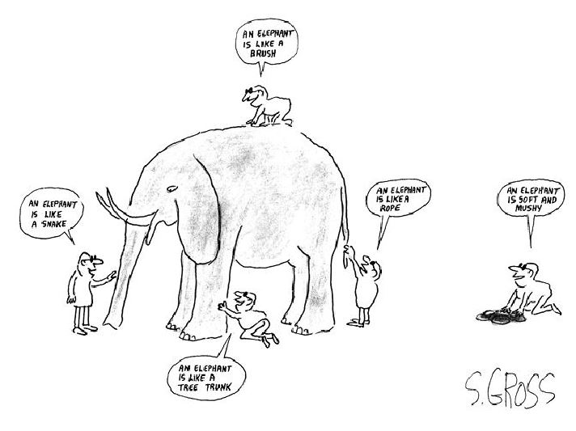

Slide 71
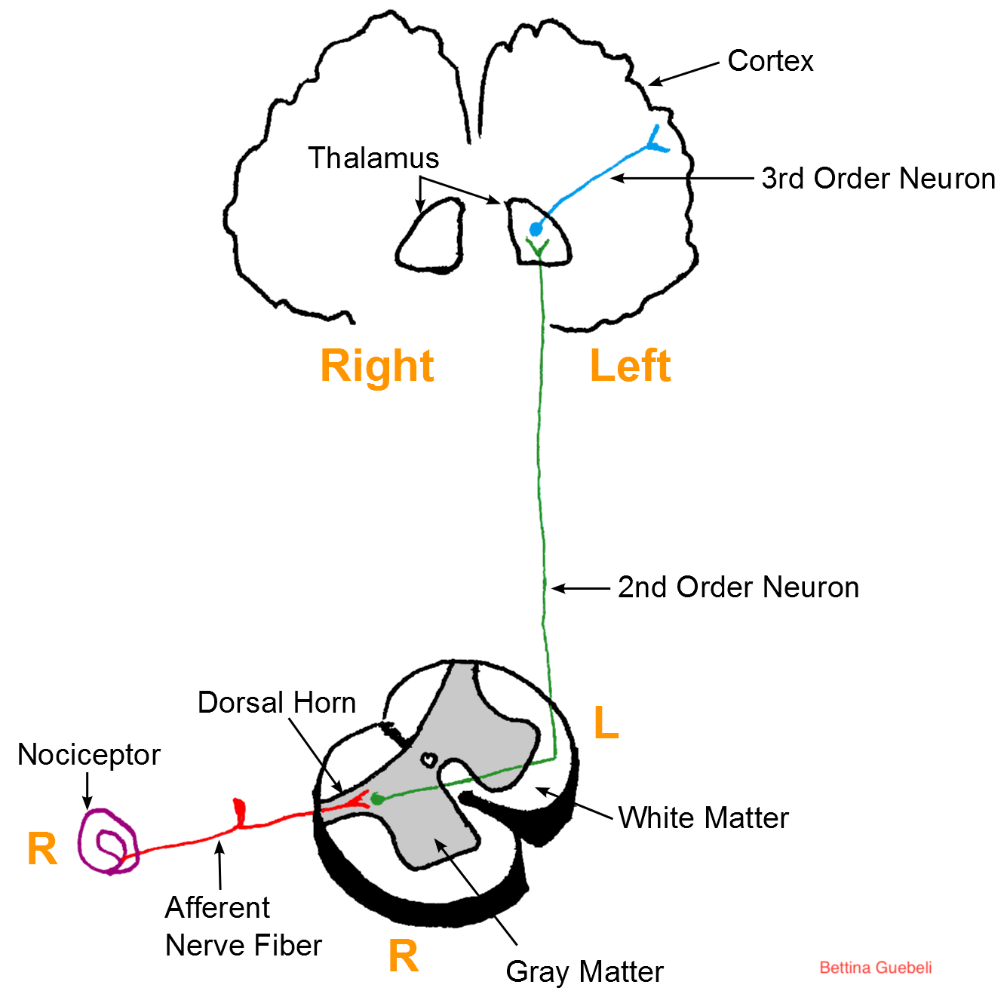
Afferent Pain
Acute pain vs Chronic Pain

Slide 72
Somatization-Hysteria-Functional disorders
The expression of psychological dysfunction through physical symptoms
The patient complains of a symptom that has no medical cause
A diagnosis of exclusion
Notes:
call psych if the tests are negative
Remember the caveat is that many are found later

Slide 73
Hysteroepilepsy
Described by JM Charcot after he placed “non-insane” women on the same ward (this included placing epilepsy with hysteria)
Charcot thought hysteroepilepsy was ”organic”
”…perfectly legitimate pathological phenomena, in which the will of the patient counts for nothing, absolutely nothing”*
Babinski eventually persuaded him that these patients may be responding to suggestion and attention
*
CLINICAL LECTURES ON DISEASES OF THE NERVOUS SYSTEM DELIVERED AT INFIRMARY LA SALPETRIERE BY PROFESSOR J. M. CHARCOT, VOL 3 LONDON: THE NEW SYDENHA.M SOCIETY. 1889.

Slide 74
Pain and sensory amplification
Sensory information is integrated at every level of the nervous systems
Nerve endings are most sensitive to a particular stimulus, but will react to intense stimuli of other types, and are “tuned” by the surrounding nerves and tissues.
The neurons that carry pain are located in the dorsal area of the spine, and then send signals to the brain (thalamus) and up and down the spine to modulate other incoming signals and to modulate motor output.
Pain is modulated by efferent nerves from the brain, spine and local tissue

Slide 75
A psychological model of functional disorders
Unconscious psychic conflict
Unresolvable life problems
Vulnerable temperament
Major depression
Conditioned pathological behavior

Slide 76
A psychological model of functional disorders
Unexplained distress and anxiety
Unstable relationships
Unconscious Psychic conflict
Unresolvable life problems
Excessive focus on internal sensation
Focus on negative sensation
Vulnerable temperament
Nihilistic interpretations
Major depression
Ruminations about illness
Fatigue
Conditioned pathological behavior
Demoralization
Social isolation and loss of support

Slide 77
A psychological model of functional disorders
Unexplained distress and anxiety
Somatic interpretation of anxiety
Unstable relationships
Unconscious Psychic conflict
Unresolvable life problems
Illness as a coping mechanism
Excessive focus on internal sensation
Medically sanctioned comfort
Focus on negative sensation
Search for a physical explanation
Vulnerable temperament
Nihilistic interpretations
Family support for organic cause
Stigma of psychiatric illness
Major depression
Ruminations about illness
Stigma of psychiatric treatment
Fatigue
Medically supported income
Conditioned pathological behavior
Demoralization
Medical psychological support
Social isolation and loss of support
Hope for a ”cure”

Slide 78
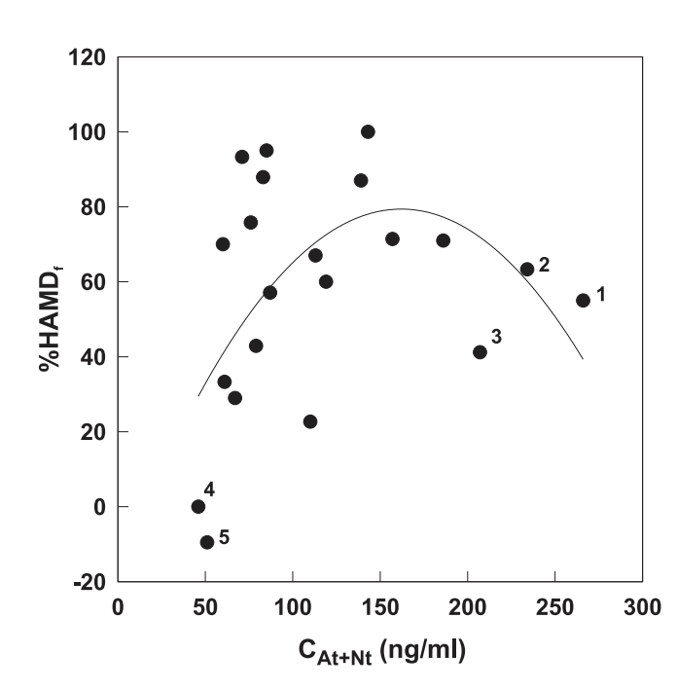
Serum Levels of Amitriptyline and Therapeutic Effect in Non-Delusional Moderately to Severely Depressed In-Patients: a Therapeutic Window Relationship
Ulrich S, Northoff G, Wurthmann C, Partscht G, Pester U, Herscu H, Meyer FP. Serum levels of amitriptyline and therapeutic effect in non-delusional moderately to severely depressed in-patients: a therapeutic window relationship. Pharmacopsychiatry. 2001 Jan;34(1):33-40.
Fig. 1 Relationship between therapeutic effect (percent change of HAMD, final value) and the sum of serum levels of At and Nt (CAt+Nt, mean of 4 measurements) in 21 depressed patients, regression analysis according to quadratic model: r2 = 0.267, p = 0.061, the numbers indicate patients as discussed in the text.

Slide 79
Briquet’s syndrome (Briquet P, Traité clinique et therapeutique de l'hystérie. Paris J.B. Bailliere et fils:1859
Dramatic or complicated medical history beginning before the age of thirty-five
15 of the following symptoms in 9/10 of the groups
feeling sickly for most of her life, headache
blindness, paralysis, anesthesia, aphonia, fits or convulsions, unconsciousness, amnesia, deafness, hallucinations or urinary retention
fatigue, lump in the throat, fainting spells, visual blurring, weakness or dysuria
breathing difficulty, palpitation, anxiety attacks, chest pain or dizziness
anorexia, weight loss, marked fluctuations in weight, nausea, abdominal bloating, food intolerances, diarrhea or constipation
abdominal pain or vomiting
dysmenorrhea, menstrual irregularity, including amenorrhea for at least two months, or excessive menstrual bleeding
Sexual indifference, sexual frigidity, dyspareunia, other sexual difficulties or vomiting for all nine months of pregnancy
back pain, joint pain, extremity pain, burning pains of the sexual organs, mouth or rectum or other bodily pains
nervousness, fears, depressed feelings, need to quit working or inability to carry on regular duties because of feeling sick, crying easily, feeling life was hopeless, thinking a good deal about dying, wanting to die, thinking of suicide or suicide attempts

Slide 80
Start with a diagnostic formulation…even a wrong one
Do an adequate workup
Look where no one has looked
Have a differential diagnosis that includes things you don’t think are the problem
Choose a diagnostic formulation that follows the general rule that a person usually only has one rare condition but…
Statistically, someone has more than one rare condition
Is there a condition that can unite the elements of the case

Slide 81
Work-up (as suggested by symptoms)
GI
whole gut, endoscopy, MRI defecography, anorectal manometry, pH probe
Rheumatologic/Immune
ESR, CRP, ANA ,DNA, RNP, smith, SS-A/SS-B, Anti Scl-70, Mayo paraneoplastic panel, GAD, Anti-smooth muscle, RF, ganglioside ab, phospholipid ab, Immunoglobulins and subclasses, tryptase (24h histamine), Gliadin TTG, HLA-DQ2, HLA-DQ8, TPO thyroid, RPR
Neurologic
Biopsy for small fiber neuropathy, nerve conduction
Endocrine
Chromogranin A
Cardiac/autonomic
Tilt table, others as available
Imaging

Slide 82
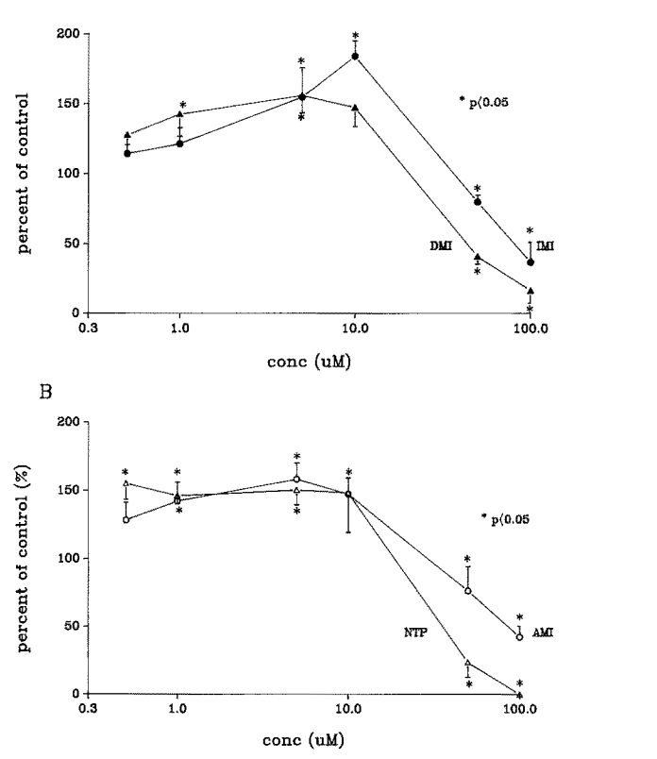
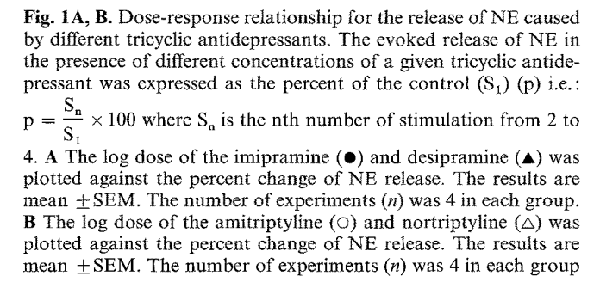
Biphasic effect of tricyclic antidepressants on the release of norepinephrine from the adrenergic nerves of the rabbit heart
Somogyi GT, Perel JM. Biphasic effect of tricyclic antidepressants on the release of norepinephrine from the adrenergic nerves of the rabbit heart. Psychopharmacology (Berl). 1991;104(2):237-43

Slide 83
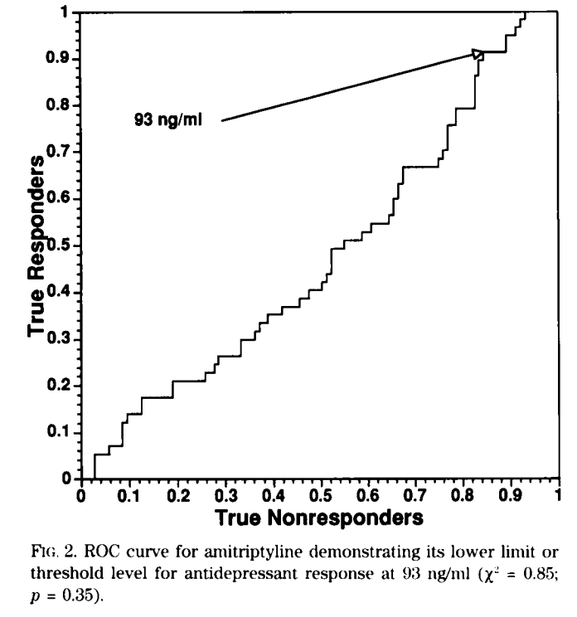
Tricyclic antidepressant concentrations in plasma: an estimate of their sensitivity and specificity as a predictor of response
Perry PJ, Zeilmann C, Arndt S. Tricyclic antidepressant concentrations in plasma: an estimate of their sensitivity and specificity as a predictor of response. J Clin Psychopharmacol. 1994 Aug;14(4):230-40

Slide 84
A word about doses and trials
Get levels on all TCA’s and anticonvulsants
Ask experienced people the highest dose to use and get there
Patients very seldom have had trials with appropriate doses
Patients very seldom have had trials with levels

Slide 85
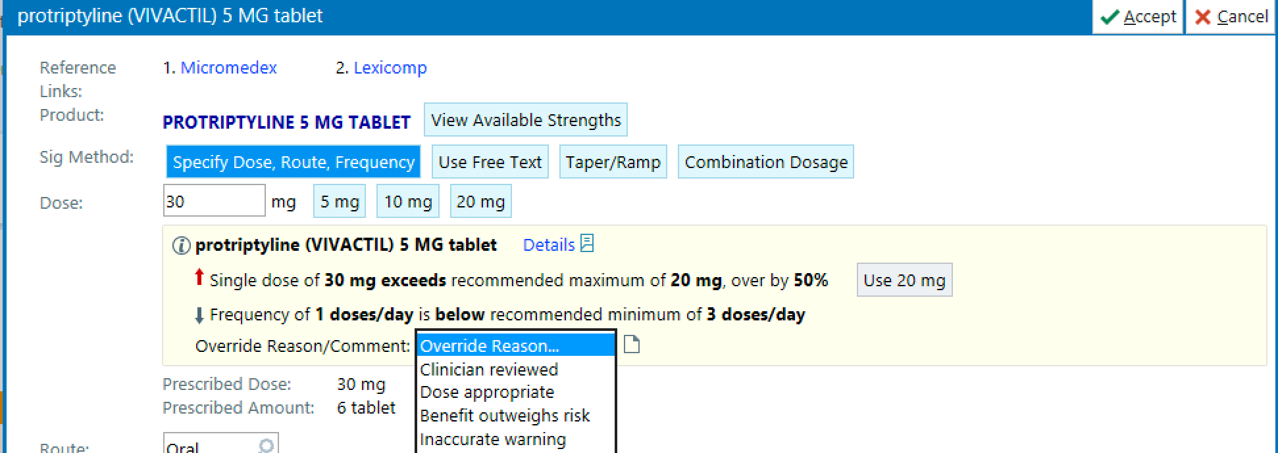
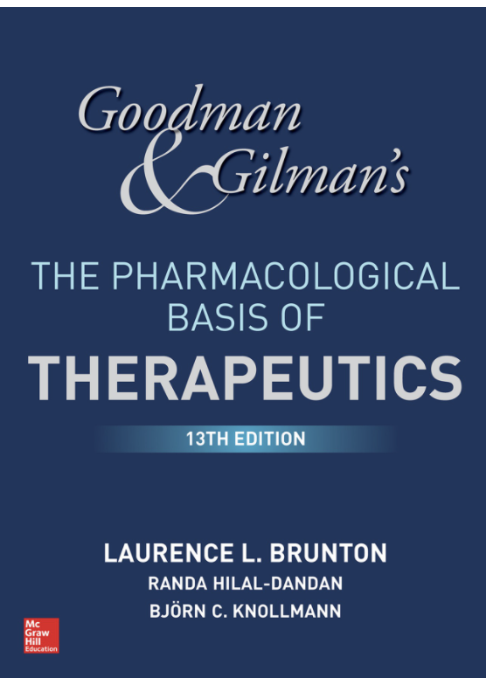
An example of one of the things that interferes with good pharmacological management
EPIC warning
Maximum
Recommended dose
20 mg a day
Recommended dose 15-40 mg
from Goodman and Gilman
EPIC warning
Frequency should be
3 tmes a day
The half-life of protriptyline
is approximately 74 hours

