Slide 1
Selective targeting of bad bugs in the gut may have many health benefits
Nebojsa Janjic, Ph.D.
Crestone, Inc.

Slide 2
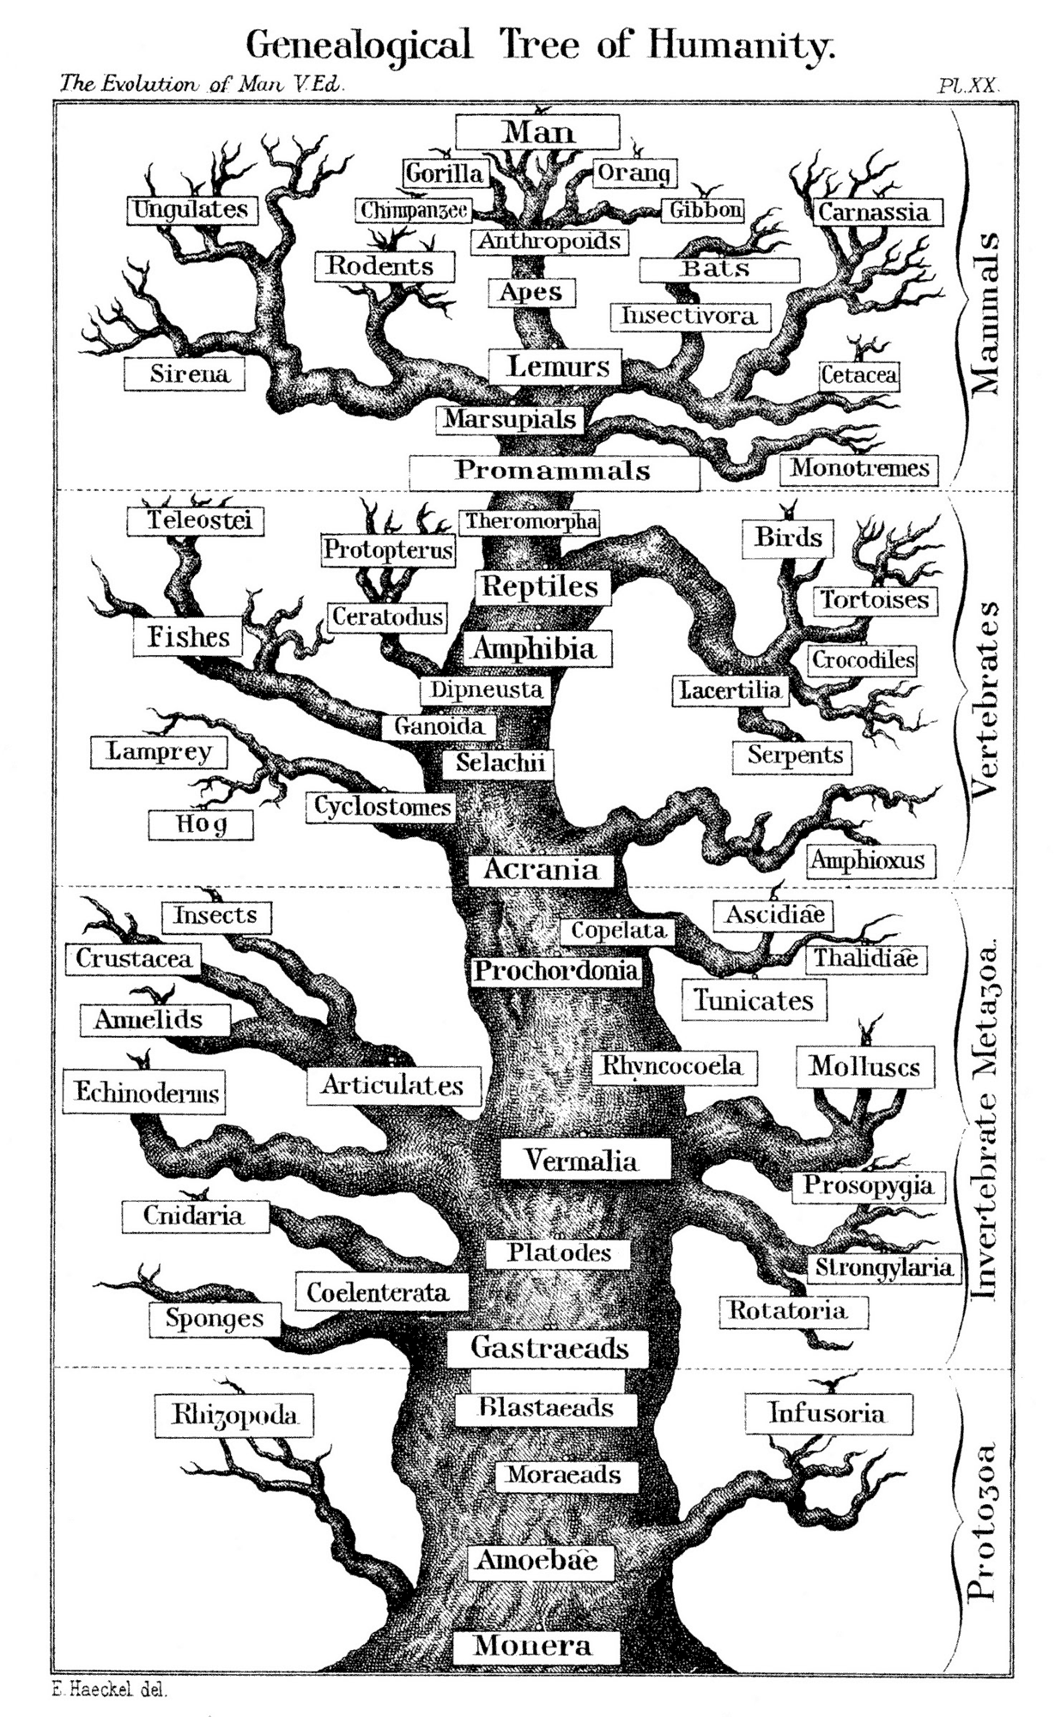
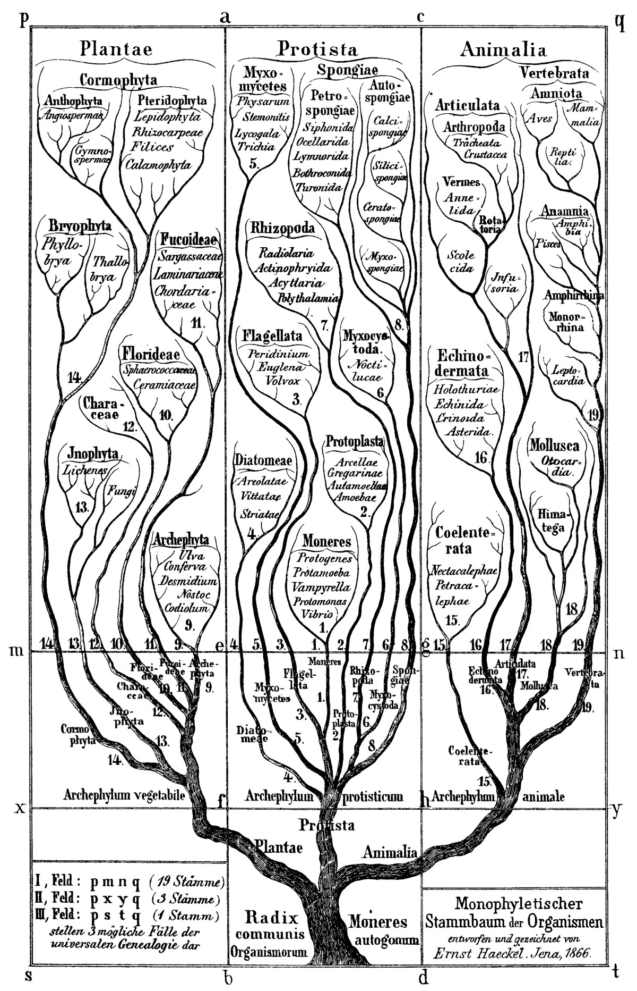
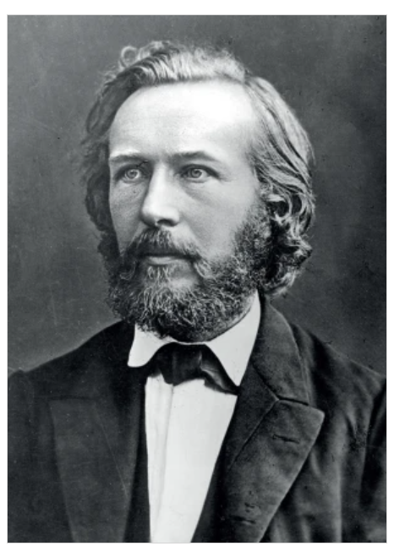
Life, sorted
Species in the context of evolution: phylogeny
Sorted based on appearance
Ernst Haeckel
Haeckel (1866) General Morphology of Organisms
Haeckel (1879) The Evolution of Man
1866
1879

Slide 3
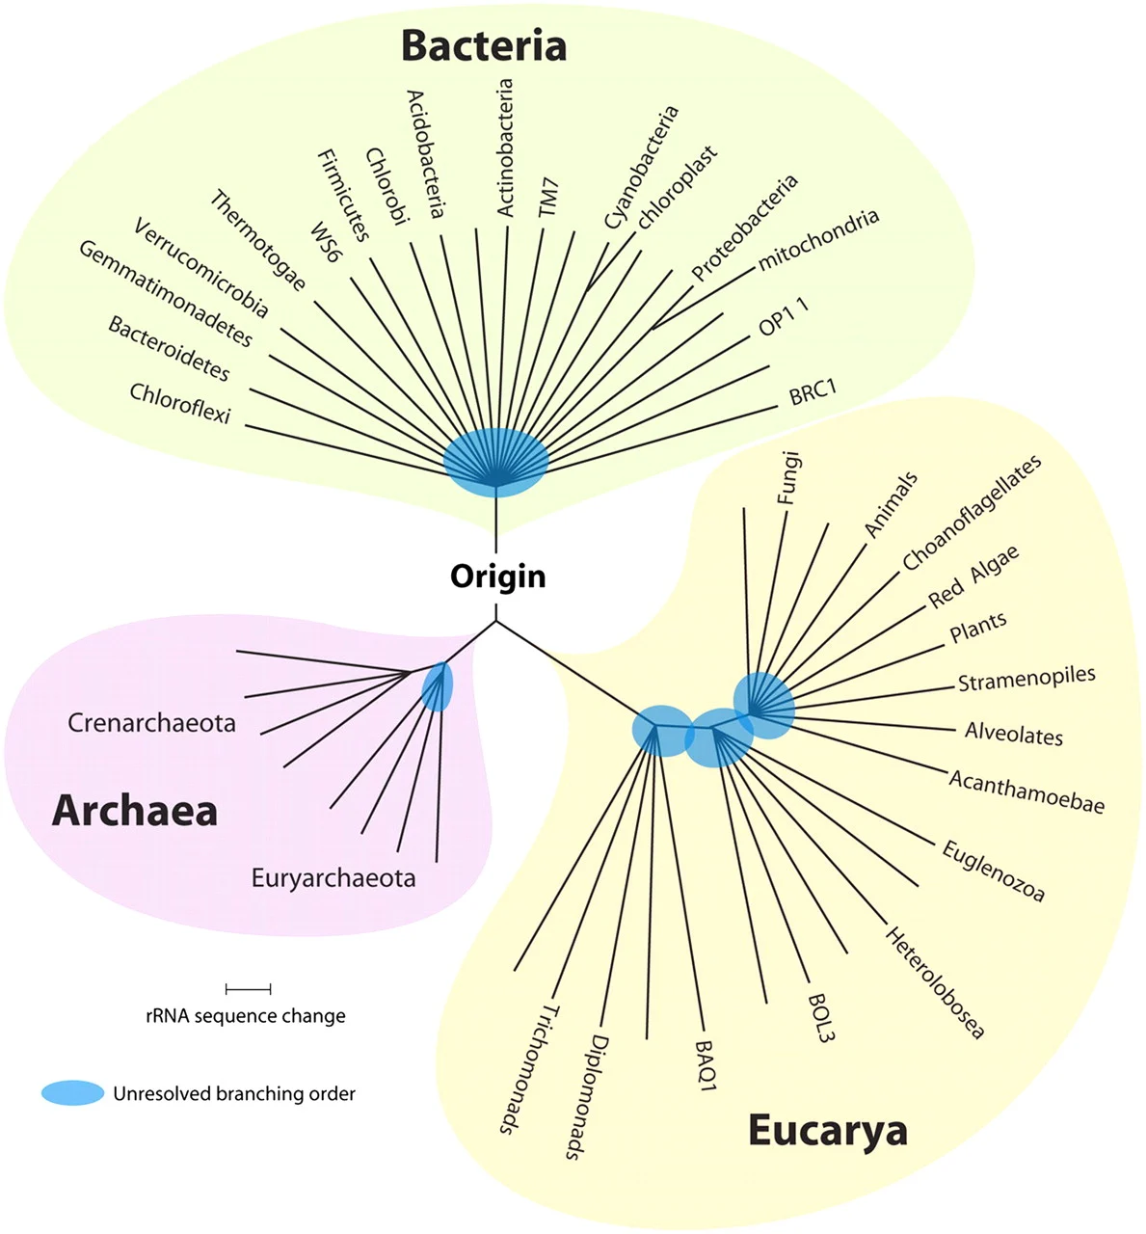
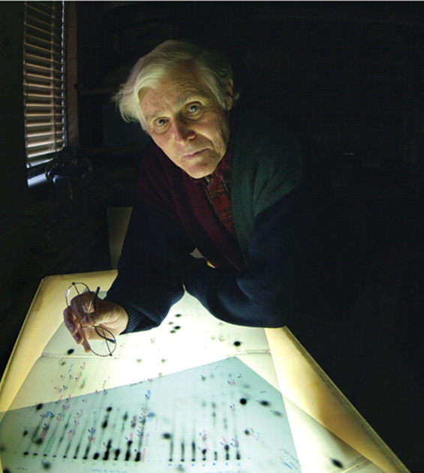
Life, rearranged
All life has similar molecular machinery
DNA → RNA → Protein
Phylogeny based on ribosomal RNA sequence, rather than appearance
Carl Woese
…AAUGCCGAUCAAGUAUCG…
…AAUGCCGAUCGAGAAUCG…
…AAUGCCGAUGGUCCGAUG…
Photo by Jason Lindley
Woese and Fox (1977) Proc. Natl. Acad. Sci. 74, 5088
Nair (2012) Proc. Natl. Acad. Sci. 109, 1021
Pace (2009) Microbiol. Mol. Biol. Rev. 73, 565

Slide 4

We can now detect organisms we can’t culture
Norm Pace, in the “lab”
Discovery of rich bacterial communities in:
  Thermal vents (like Yellowstone)
  Caves
  New York subways
  Shower curtains
  Intestines
Caves are cool
Photo by Glenn Asakawa
Stahl et al. (1984) Science 224, 409
Pace (2009) Microbiol. Mol. Biol. Rev. 73, 565

Slide 5
Adding time: abridged history of the Earth
Humans
Mammals
First life
Great oxygenation event
Dinosaurs
Moon-forming impact
Cambrian explosion
4000
3000
2000
1000
0
Million years

Slide 6
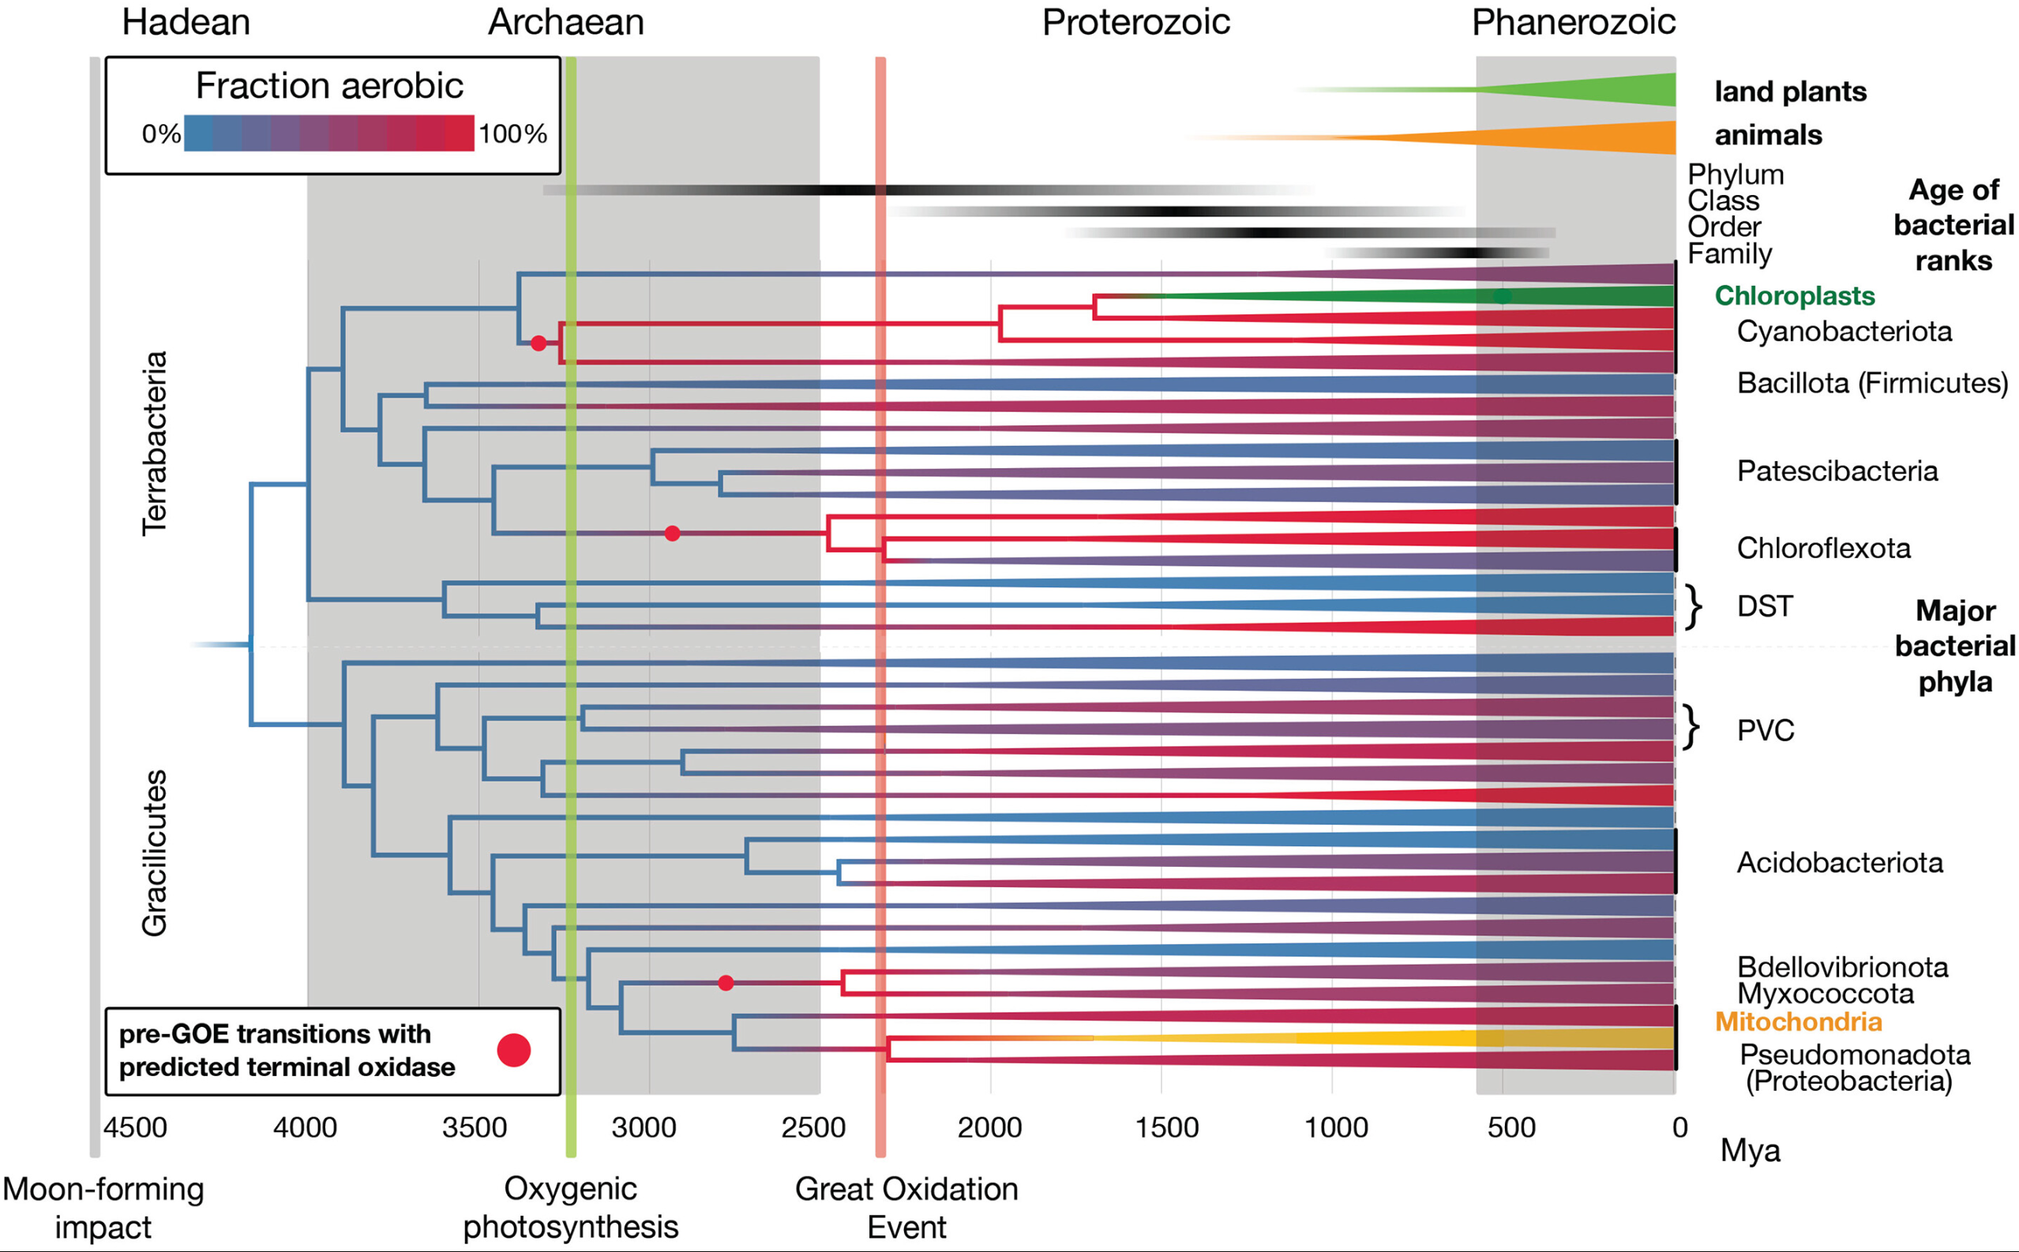
Anaerobic organisms were the first lifeforms on Earth
Oxygen emerged late
Humans emerged really late
GI tract is mostly anaerobic
More than 99% of gut bacteria are obligate anaerobes
Davín et al. (2025) Science 388, 50

Slide 7





Humans host many bacteria
You are the environment
We are your hosts
Welcome!

Slide 8

Bacterial cells and genes outnumber ours
Feeling small
Don’t worry, we are in this thing together
30 trillion human cells
39 trillion bacterial cells
Microbiota
20 thousand human genes
2-20 million bacterial genes
Microbiome
Sender et al. (2024) Cell 164, 337

Slide 9
Most gut bacteria are beneficial
Immune system stimulation
Extraction of energy from food
Nutrient metabolism and fermentation
Short-chain fatty acid synthesis
Maintenance of colon epithelium
Protection against pathogens
(colonization resistance)

Slide 10
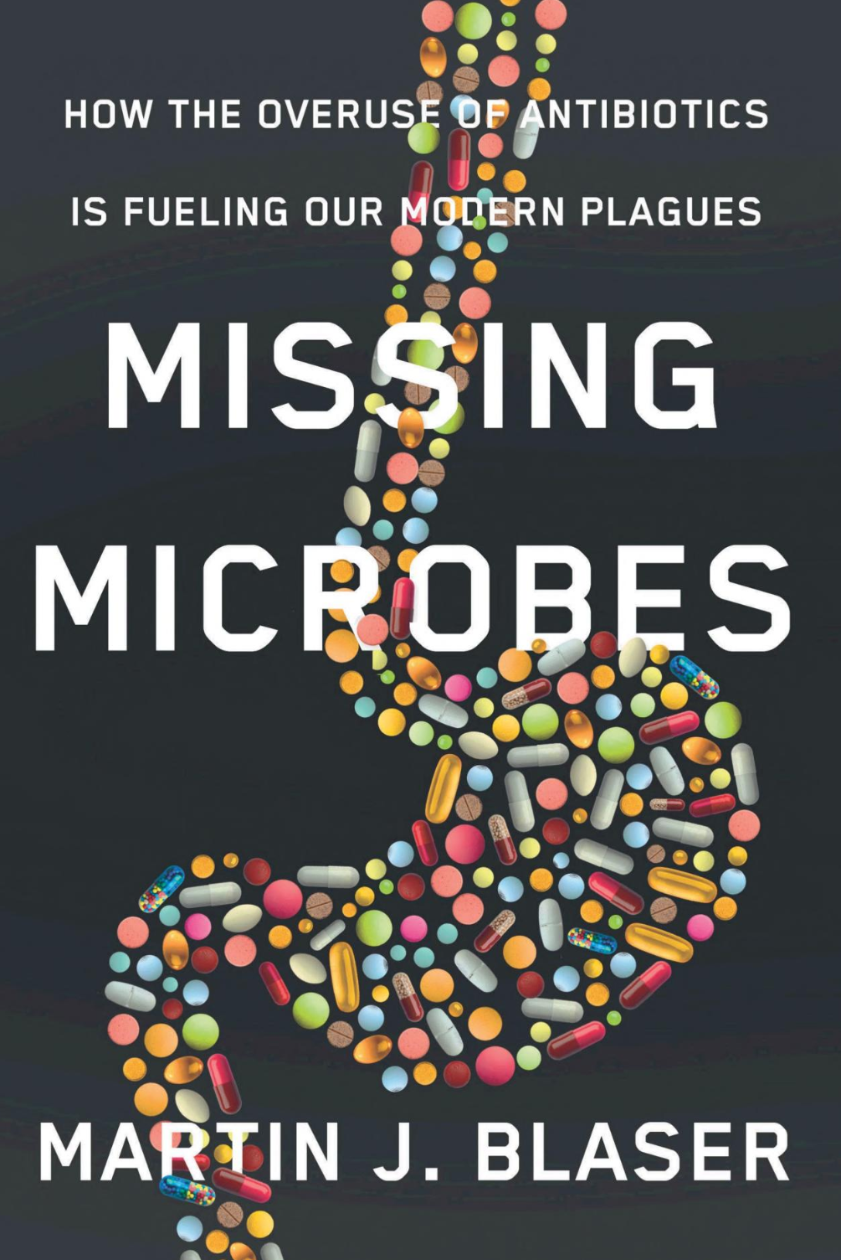
Modern life has compromised microbial diversity
↑ Processed food
↓ Fiber consumption
↑ Antibiotics use
↓ Family size
↓ Breast feeding
↑ C-sections

Slide 11
Damage to gut flora weakens colonization resistance
Most infections are treated empirically (with broad-spectrum antibiotics)
This causes massive damage to gut flora
And antibiotic-associated diarrhea, mostly caused by Clostridioides difficile
( )
Finally, room to grow
Dysbiosis
C. difficile overgrowth

Slide 12
Toxinogenic C. difficile is a bad bug
Intestinal epithelial cells
Toxins A and B (and other toxins) encoded on pathogenicity island (PaLoc) cassette
  Cause severe damage to intestinal epithelium
tcdR
tcdB
tcdE
tcdL
tcdA
tcdC
Toxin B
Toxin A
Rho GTPase glucosylation
Disruption of cytoskeleton
Breakdown of tight junctions
Cell death

Slide 13
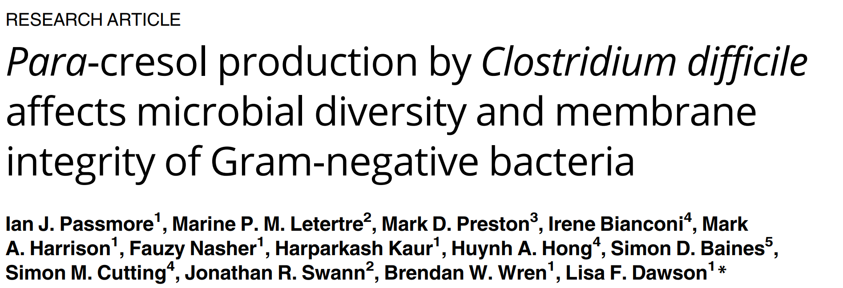
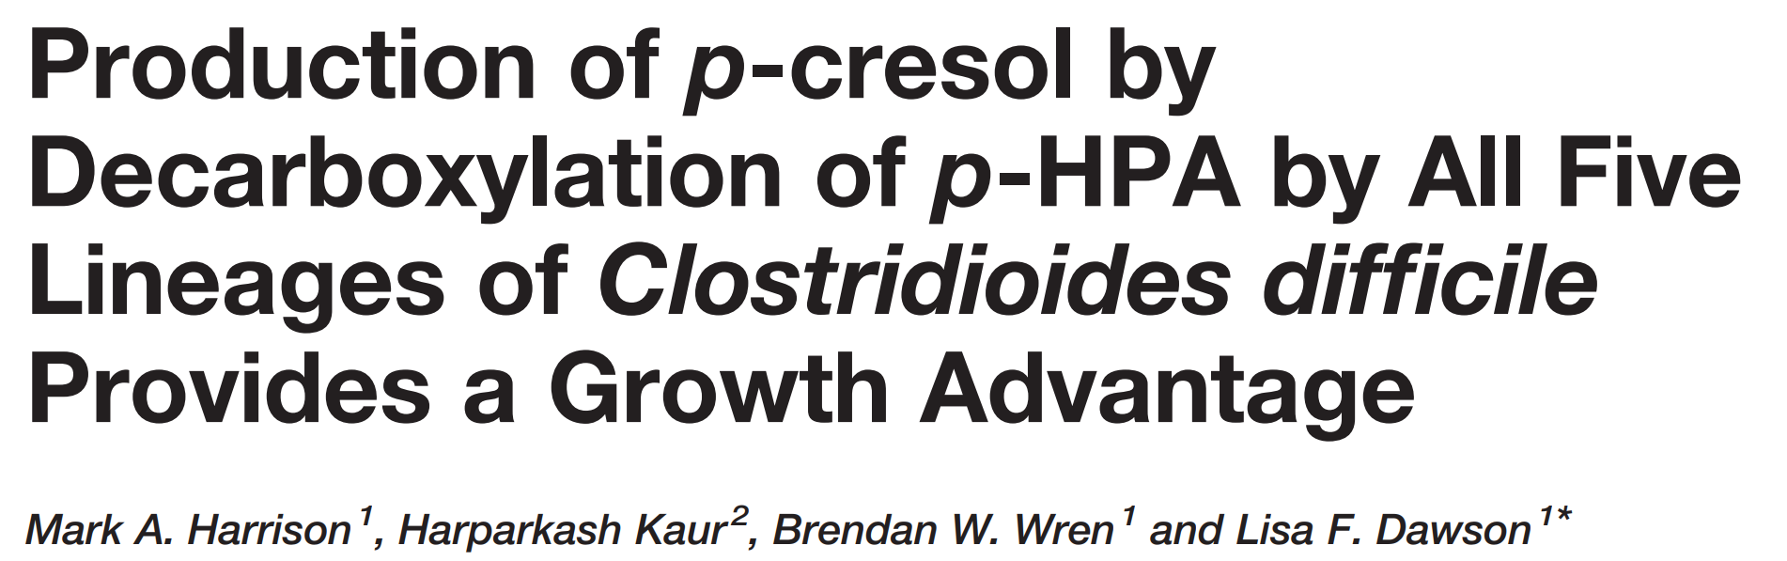
C. difficile also actively suppresses other gut bacteria
C. difficile metabolizes tyrosine to produce p-cresol
  Found in mM levels in stool
Used as a biological warfare agent
tyrosine
p-cresol
Passmore et al. (2018) PLoS Pathog. 14, e1007191
Harrison et al. (2021) Front. Cell. Infect. Microbiol. 11, 757599

Slide 14
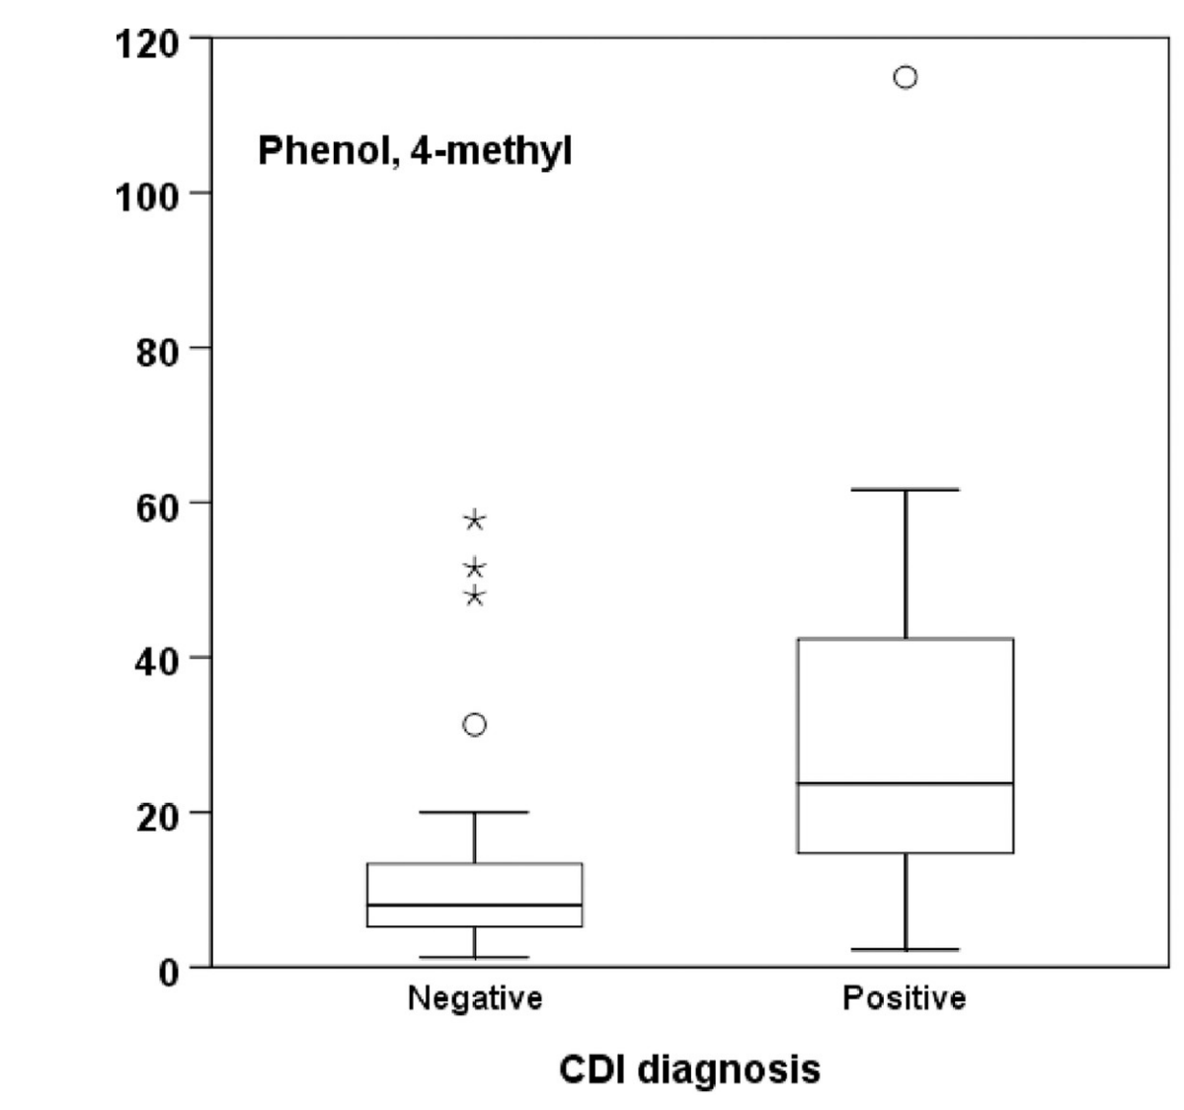
Some nurses claim they can smell C. difficile on patients
Not a great stand-alone diagnostic test
Maybe a rule-out test
But there are definitely higher levels of p-cresol in CDI patients
p-Cresol levels in stool
VOC Emission
CDI Diagnosis
Burdette et al. (2007) Clin. Infect. Dis. 44, 1142
Rao et al. (2013) Clin. Infect. Dis. 56, 615
Patel et al. (2019) PLoS ONE 14, e0215256

Slide 15
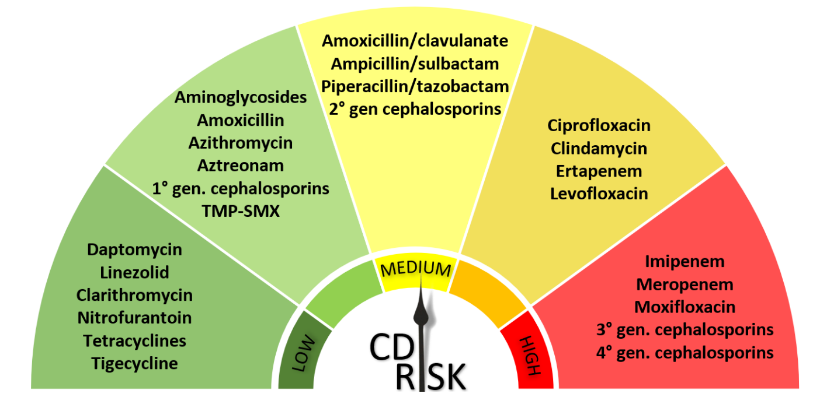
Broad-spectrum antibiotics increase risk of CDI
Some are worse than others
Di Bella et al. (2024) Clin Microbiol Rev 37, e00135-23

Slide 16
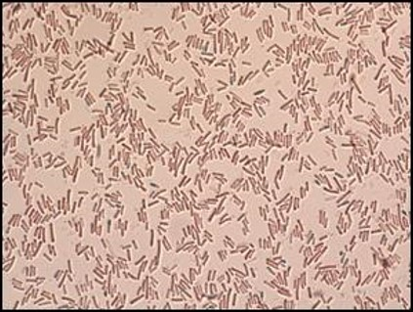
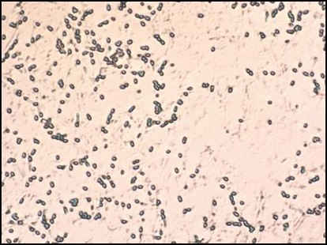
Under stress, C. difficile forms spores
Spores are resistant to heat, alcohol, antibiotics, lack of nutrients
Spores
Vegetative cells
Stress
Sporulation
Good times
Germination

Slide 17



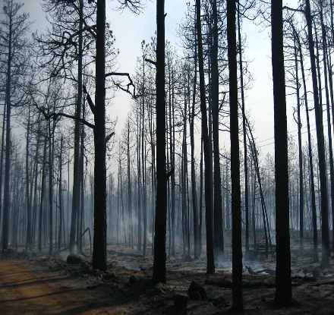
Spore formation is an evolutionary superpower
No need to be nice
  To your host
  Or your neighbors
Easy spread
Survival in harsh conditions
Get in
Hit
Run
Sleep (a long, long time) and travel (near and far)
Repeat

Slide 18
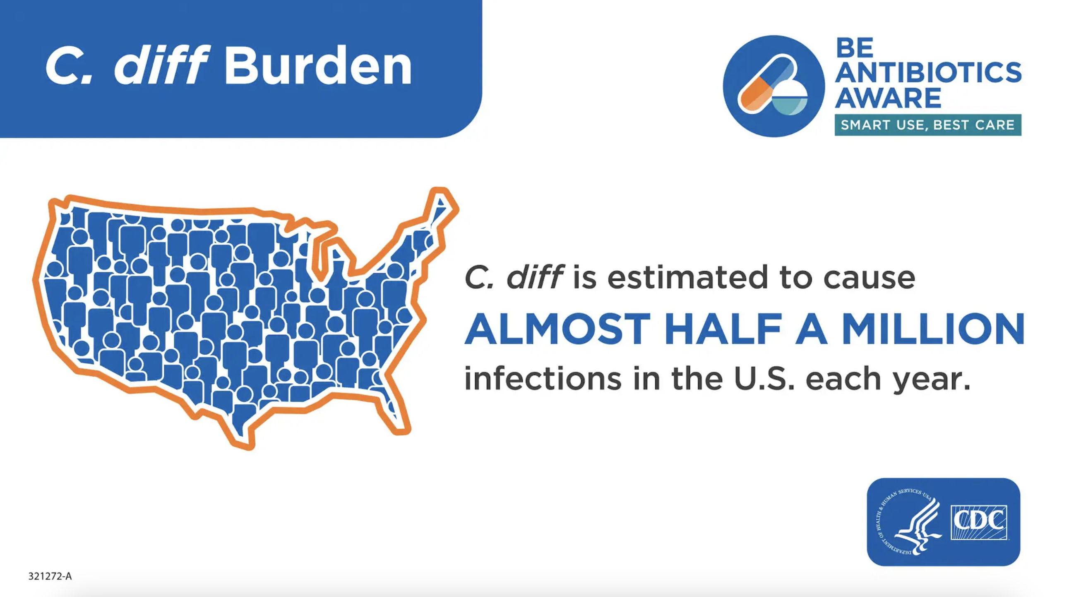
C. difficile infection (CDI) remains an urgent threat (CDC)
High death rate (1 in 11 patients)
C. difficile spores are everywhere
“Sterile” glove
https://www.cdc.gov/cdiff
https://www.cdc.gov/c-diff/media/images/USBurden.jpg
Bobulsky et al. (2008) Clin. Infect. Dis. 46, 447

Slide 19
The biggest clinical problem with CDI is recurrence
Initial episode of CDI is successfully treated with one of several available antibiotics
  Metronidazole (now discouraged)
  Vancomycin
  Fidaxomicin
But recurrence rates remain high
80
~65%
60
~45%
40
Recurrence rate (%)
~25%
20
0
Initial episode
First recurrence
Second recurrence
Kelly (2012) Clin. Microbiol. Infect. (Suppl. 6) 18, 21

Slide 20

Vancomycin, the most commonly-used treatment for CDI, is also a broad-spectrum antibiotic
Vancomycin
C. difficile recurrence
Cure, but ongoing dysbiosis
>20%

Slide 21
Toward optimal CDI treatment
Stop toxin production and sporulation (rapidly)
Cause minimal disruption of beneficial gut flora
Essential Gene
Narrow Spectrum
Protein Synthesis Inhibitor
Stop this!
DNA
RNA
Protein
Toxins
Spore proteins
Ideal target

Slide 22
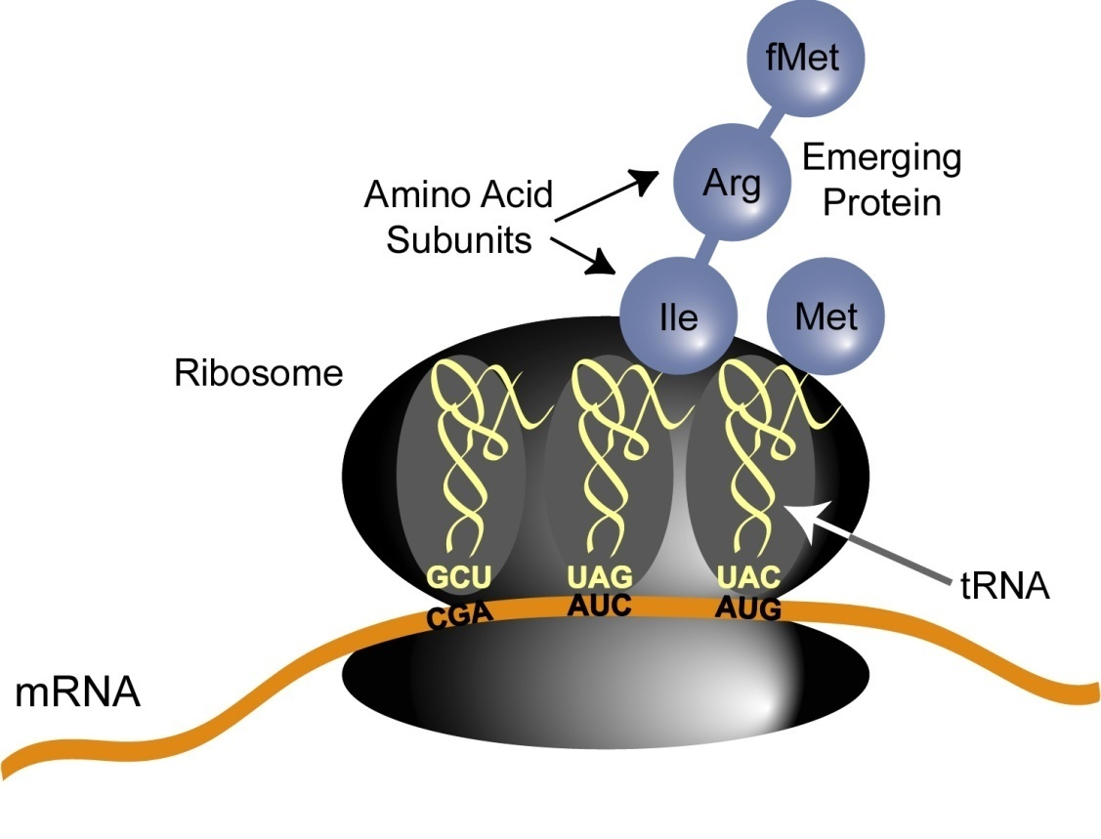
Methionyl tRNA synthetase (MetRS) is novel drug target
Loads methionine to tRNA^{fMet} and tRNA^{Met}
Essential enzyme in all bacteria
Unique among tRNA synthetases
  Needed for both initiation (fMet) and elongation (Met) steps
Bacterial and eukaryotic enzymes are different
  Large safety window

Slide 23
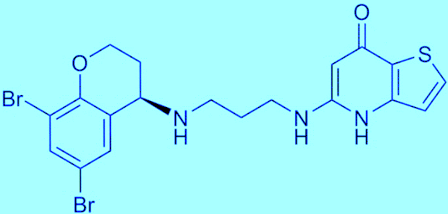
CRS3123 is a potent inhibitor of C. difficile MetRS
Identified from diaryldiamine SAR series
  Originally licensed from GSK
Small molecule, fully synthetic
One chiral center
Only R-enantiomer is active
 | CRS3123 R-Enantiomer | CRS3124 S-Enantiomer
K_{i}, pM | 20 | 80,000
MIC, μg/mL | 0.5 | >32
CRS3123

Slide 24
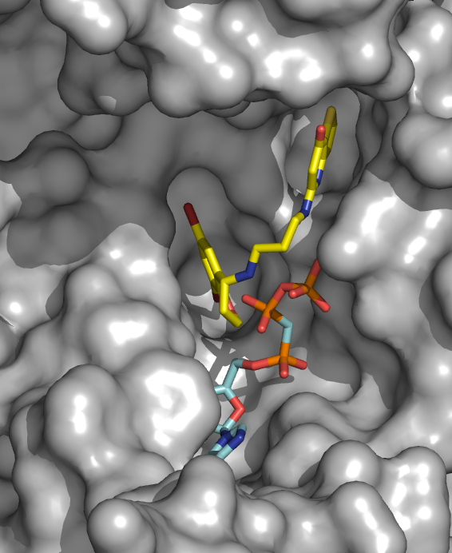
CRS3123 binds to active site of C. difficile MetRS
CRS3123 occupies methionine binding pocket
  Competitive inhibitor of methionine binding
  Cooperative (uncompetitive) binding with ATP
    This is important because there is a lot of ATP inside cells
Met binding pocket
CRS3123
K_{i} = 20 pM
ATP analog
CRS3123 and ATP analog bound to C. difficile MetRS

Slide 25
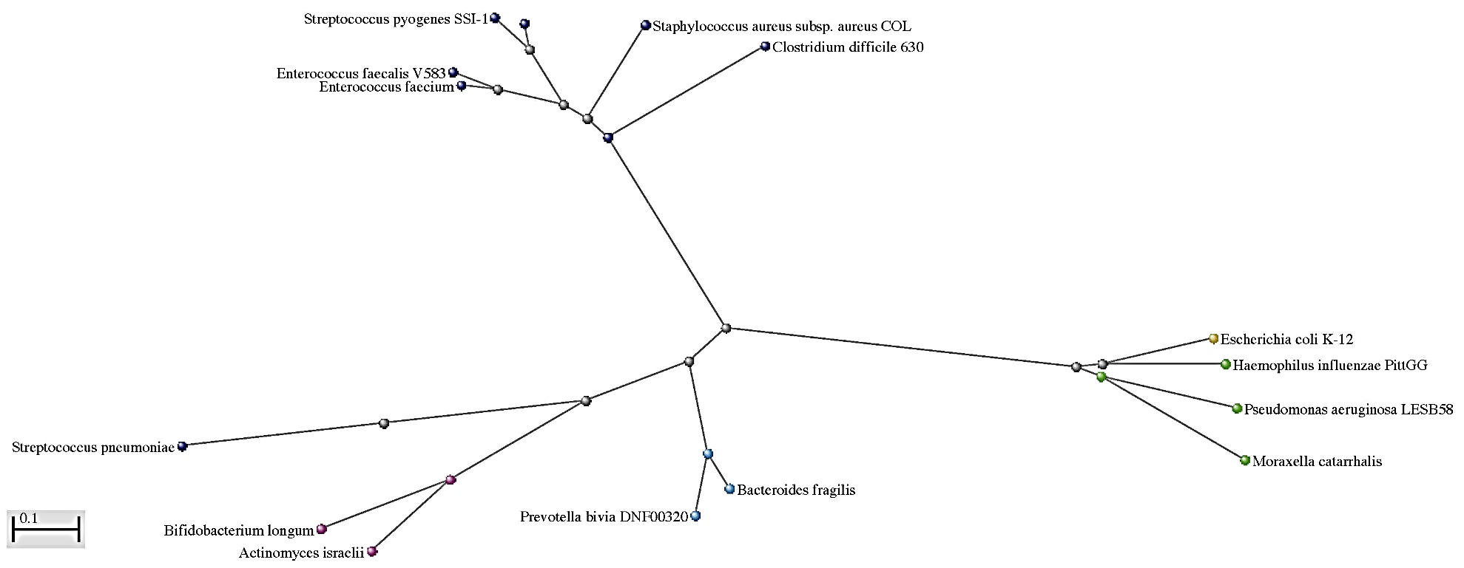
MetRS phylogeny explains narrow spectrum of CRS3123
MetRS Type 1
Type 1: Susceptible
S. pyogenes
S. pneumoniae
S.aureus
C. difficile
E. faecalis
E. faecium
C. perfringens
Type 2: Not-susceptible
C. bolteae
Most Gram-positive aerobes
MetRS Type 2
All Gram-negatives
E.coli
Some Gram-positive aerobes
H. influenzae
S. pneumoniae 2
P. aeruginosa
Bacteroides
M. catarrhalis
Actinomyces
Prevotella
Bifidobacterium
ANAEROBES
(normal gut microbiome)

Slide 26
CRS3123 showed favorable safety and tolerability in two phase 1 studies
Single ascending dose (DMID10-0008)
  5 cohorts: 100, 200, 400, 800, 1200 mg
  https://clinicaltrials.gov/ct2/show/NCT01551004
Multiple ascending dose (DMID10-0009)
  3 cohorts: 200, 400, 600 mg; twice daily (BID) for 10 days
  https://clinicaltrials.gov/ct2/show/NCT02106338
Most adverse events mild, no serious adverse events
Nayak et al. (2017) Antimicrob. Agents Chemother. 61, e02760
Lomeli et al. (2019) Antimicrob. Agents Chemother. 64, e01395

Slide 27
CRS3123 has low oral bioavailability
High intestinal drug levels (above 1,000 µg/ml) observed at all three doses
Dosed twice-daily for 10 days
MIC: minimum inhibitory concentration
MPC: mutant prevention concentration
Lomeli et al. (2019) Antimicrob. Agents Chemother. 64, e01395

Slide 28
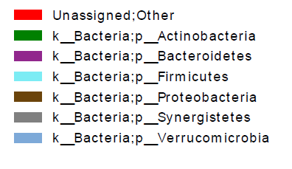
CRS3123 shows dose-dependent, minimal to moderate effect on normal gut microbiota
Relative amounts of major phyla over time
Gut microbiome data from Phase 1 study, 10-day, twice-daily (BID) dosing
  Analyzed by 16S rRNA sequencing
No major phyla lost
Verrucomicrobia
Synergistetes
Proteobacteria
Placebo
Firmicutes
Bacteroidetes
Actinobacteria
Other
200 mg BID
Phase 2 doses
400 mg BID
600 mg BID
Treat 10 Days
Post, Days
Lomeli et al. (2019) Antimicrob. Agents Chemother. 64, e01395

Slide 29
CRS3123 for CDI: phase 2 study design
Screening
Treatment
Test of Cure
Follow up
Day 1
Day 10
Day 12
Day 40
Day 70
Primary CDI or 1st recurrence
Group A
CRS3123 200 mg Oral BID
Toxin+
Group B
CRS3123 400 mg Oral BID
Group C
Vancomycin 125 mg Oral QID
Primary endpoints:
Rate of clinical cure at Test of Cure
Overall assessment of safety and tolerability
Secondary endpoints:
Time to resolution of diarrhea
Rate of recurrence
Rate of global cure

Slide 30
CRS3123 shows high initial cure rates and low recurrence rates
Clinical cure rates at test-of-cure (day 12)
  CRS3123 200 mg and 400 mg BID dosages combined 97%
  Vancomycin 125 mg QID 93%
Recurrence rates (day 40)
  CRS3123 200 mg and 400 mg BID dosages combined 4%
  Vancomycin 125 mg QID 23%
Well-tolerated at both doses of CRS3123
  https://clinicaltrials.gov/study/NCT04781387

Slide 31
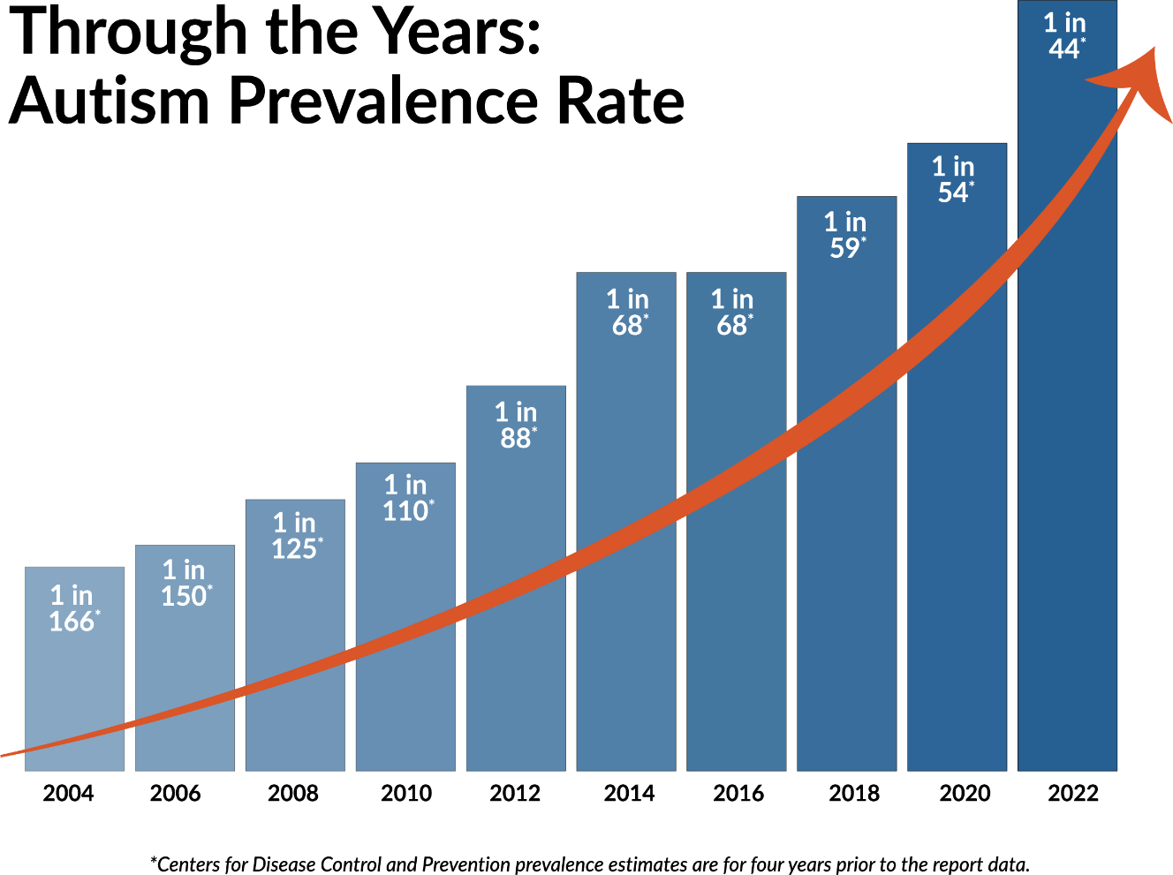
Autism: a large unmet need with limited treatment options
Increasing prevalence, reasons unclear
Affects boys 4 times more often than girls
Occurs in all racial, ethnic, and socioeconomic groups
Genetic predisposition poorly understood
No FDA-approved treatments for core symptoms
Improvement in symptoms would be highly meaningful
*
Now 1 in 31
*CDC prevalence estimates for four years prior to report date

Slide 32
Gastrointestinal (GI) problems are common in autism
GI symptoms are at least 3-fold more frequent in autistic compared to neurotypical individuals
  Constipation, diarrhea, bloating, pain
  Strongly correlated with severity of autism
Gut microbiome is less diverse
Reduced GI motility and increased permeability (“leaky gut”) are common
Bresnahan et al. (2015) JAMA Psychiatry 72, 466-74
McElhanon et al. (2014) Pediatrics 133, 872-83
Chaidez et al. (2014) J. Autism Dev. Disord. 44, 1117-27
Adams et al. (2011) BMC Gastroenterol. 11, 22
Kang et al. (2013) PLoS One 8, e68322
Kang et al. (2017) Microbiome 5, 10
Wang et al. (2019) Brain Behav. Immun. 75, 1921
Ma et al. (2019) Front. Cell. Infect. Microbiol. 9, 40
Hsiao et al. (2013) Cell 155, 1451-63

Slide 33
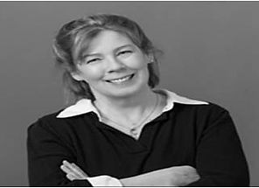
Enter Ellen Bolte
Her son, Andrew, was developing normally until 18 months of age (mid 1990’s)
He got an ear infection for which he was treated with multiple courses of broad-spectrum antibiotics
He then developed diarrhea
And rapidly descended into severe autism
Bolte (1998) Med. Hypotheses 51, 133

Slide 34
Late-onset autism is often preceded with GI symptoms
Late-onset (regressive) autism occurs in about 1/3 of the cases
History of increased antibiotics use
Onset of symptoms often follows antimicrobial therapy
GI symptoms are common at the onset and often persist
Sandler et al. (2000) J. Child Neurol. 15, 429-35
Niehus et al. (2006) J. Dev. Behav. Pediatr. 27, S120-7
Finegold (2008) Med. Hypotheses 70, 508-11

Slide 35
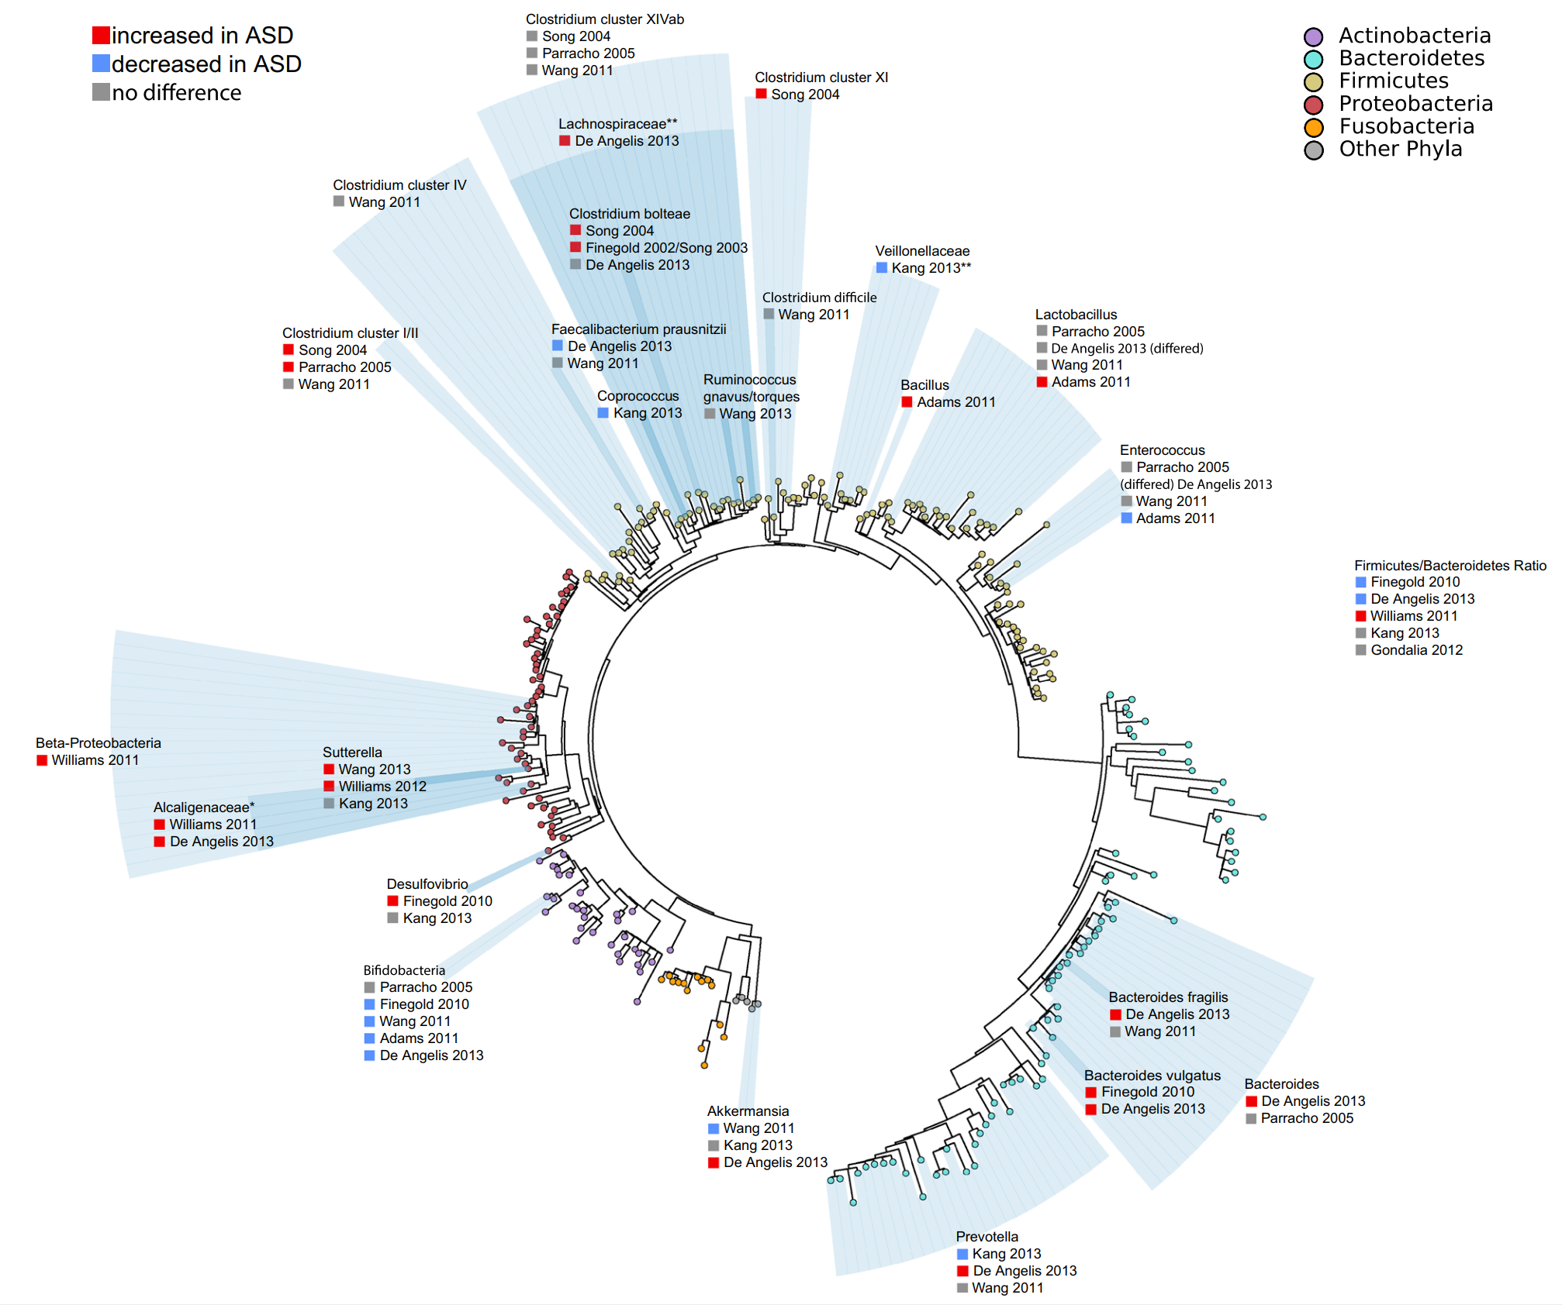
Dysbiosis in autism shows directional trends
Increased Clostridium clusters
  Most are spore-formers
  Principal producers of enterotoxins, neurotoxins, and toxic metabolites (phenols and indole derivatives)
Decreased Bifidobacterum clusters
(Clostridium perfringens)
Ding et al. (2017) J. Autism Dev. Disord. 47, 480

Slide 36
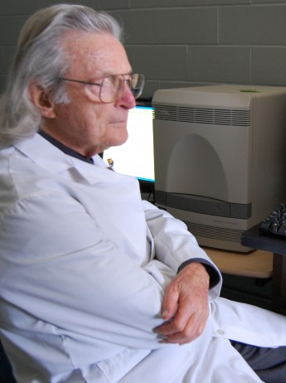
From Ellen to Sid Finegold
Ellen reached out to Sydney Finegold (UCLA)
  A leading expert in anaerobic bacteria
Together, they tested oral vancomycin in late-onset autistic children (including Andrew)
8 out of 10 children improved on treatment
But the effect did not last
In 2010, Sid called us
Sandler et al. (2000) J. Child Neurol. 15, 429-35

Slide 37
CRS3123 has activity against select Clostridium species implicated in autism
Organism | MIC (μg/mL)
 | CRS3123 | Vancomycin
(C. difficile) | 1 | 1
C. perfringens | 0.25 | 1
C. bolteae | 0.125 | 0.5
C. histolyticum | 0.5 | 1
C. ramosum | >32 | 4
Actinomyces spp. | >32 | 0.5
Bifidobacterium spp. | >32 | 0.5
Pathogens
Beneficial
Critchley et al., (2009) J. Antimicrob. Chemother. 63, 954
Ochsner et al. (2009) J. Antimicrob. Chemother. 63, 964
Citron et al. (2009) J. Antimicrob. Chemother. 63, 972

Slide 38
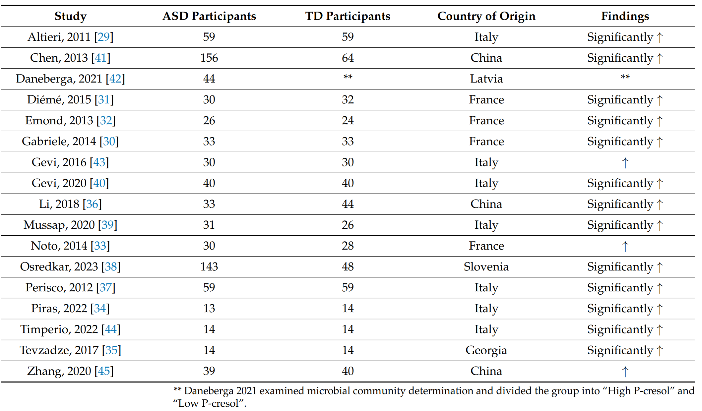
p-Cresol is elevated in autistic individuals
Elevated in 17 of 17 studies
Increased levels correlate with autism symptoms
Just correlation?
Flynn et al. (2025) Int. J. Mol. Sci. 26 1513

Slide 39



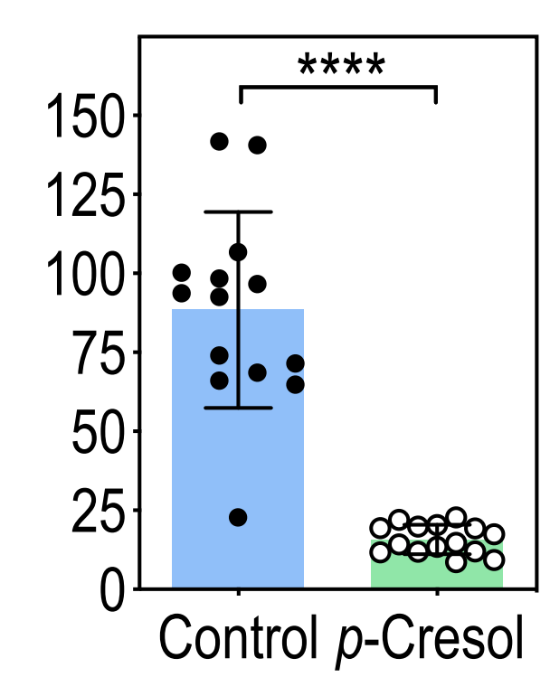
p-Cresol causes autism symptoms
p-Cresol in drinking water makes mice less social
p-Cresol in water (2 mM)
Autistic behaviors
Revert to typical behaviors
Phenotype is transplantable
The effect is not subtle
FMT
Just water
Typical behaviors
Turn to autistic behaviors
Time in social contact (s)
FMT
Bermudez-Martin et al. (2021) Microbiome 9, 157
FMT: fecal microbiota transplant

Slide 40
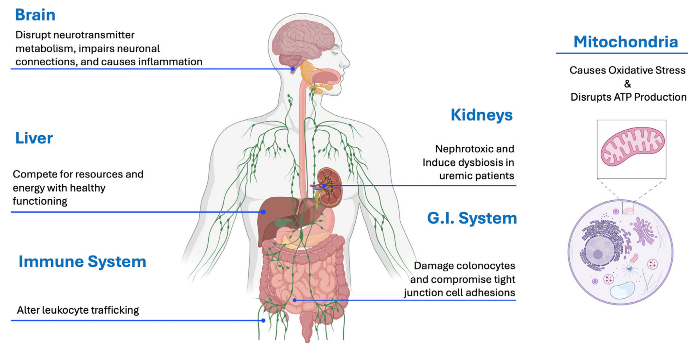
p-Cresol is toxic to multiple organs
Flynn et al. (2025) Int. J. Mol. Sci. 26, 1513

Slide 41
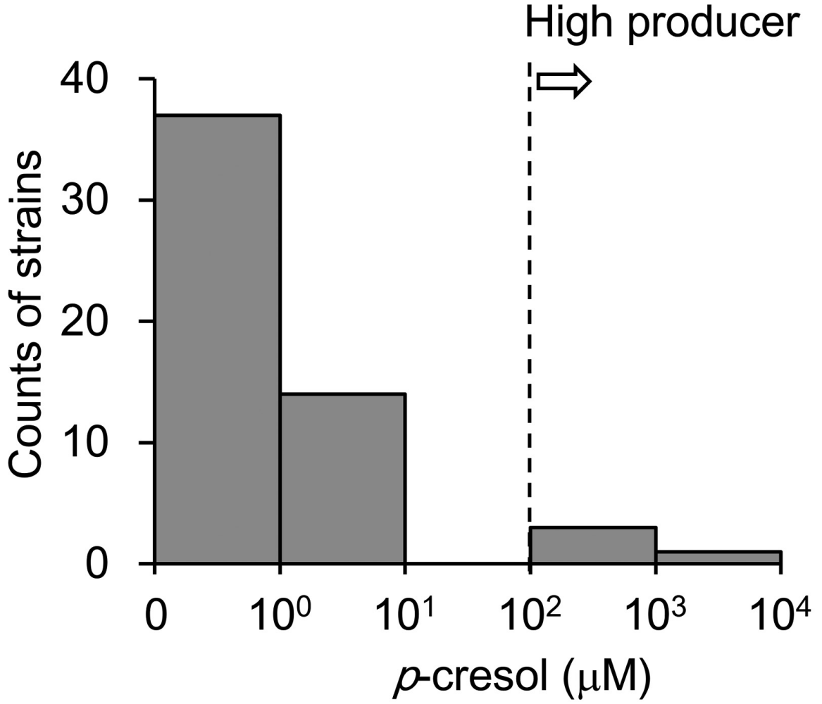
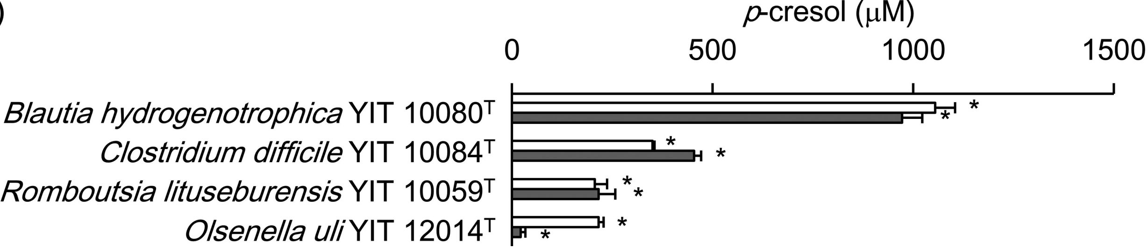
CRS3123 is active against highest producers of p-cresol
Among 55 bacteria known to produce p-cresol, 4 are markedly higher producers
All high producers have MetRS1 (but not MetRS2) gene, CRS3123 is active against all
p-cresol high producers
Rich medium
Basal medium
Saito et al. (2018) FEMS Microbiol Ecol 94, fiy125
Passmore et al. (2018) PLoS Pathog. 14, e1007191

Slide 42
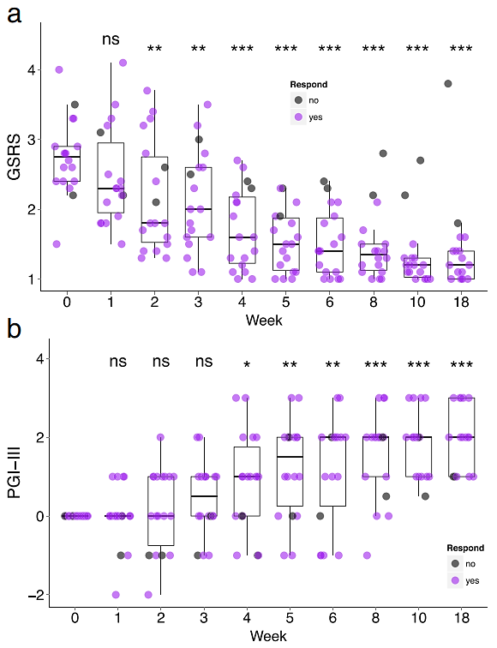
Vancomycin treatment followed by microbiota transplant improves both GI and autism symptoms
GI symptoms
Eighteen autistic children 7-16 years of age
  Oral vancomycin for 2 weeks
  Bowel cleanse
  Fecal microbiota transplant (FMT) therapy for 8 weeks
Autism symptoms
Kang et al. (2017) Microbiome 5, 10

Slide 43
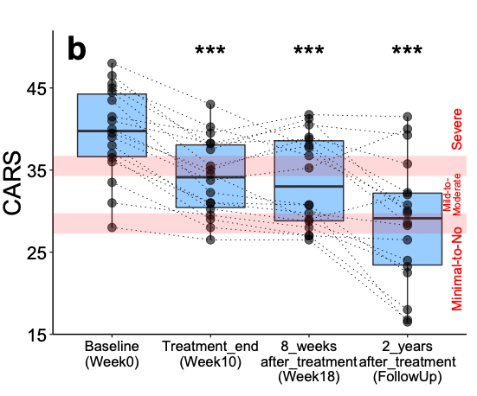
With lasting effect
Reduction in autism symptoms maintained through 2-year follow-up
Kang et al. (2017) Microbiome 5, 10
Notes:
Childhood autism rating scale
FDA provided fast Track based on these results. Keep in mind that this was an open labeled trial.

Slide 44
Can CRS3123 achieve a similar, lasting effect?
We now have an IND for autism, with a “study may proceed” letter from FDA
Enroll autistic individuals with
  GI symptoms
  Elevated levels of C. perfringens, C. bolteae and C. histolyticum
  Also elevated p-cresol levels?
What is the effect size (autism behavior and GI symptoms)?
Does narrow spectrum = less dysbiosis = longer lasting effect?

Slide 45
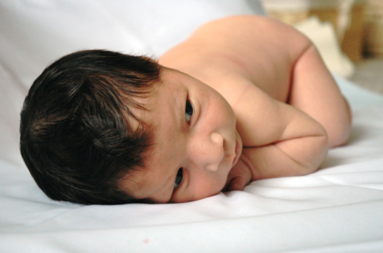

Pitt Hopkins Syndrome (PTHS): a rare, genetic, autism-like disorder
ASD-like behavioral symptoms, unique facial features, intellectual disability, speech delay
Initially described in 1978
Caused by mutation in tcf4 gene (Chr 18)
Very high incidence of GI dysfunction (~70%)
  Major clinical problem
Goodspeed et al. (2018) J. Child Neurol. 33, 233
Pitt & Hopkins (1978) Aust. Paediatr. J. 14, 182
Amiel et al. (2007) Am. J. Hum. Genet. 80, 988

Slide 46
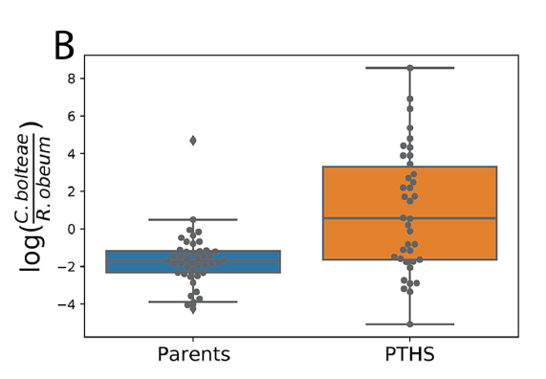


CRS3123 for PTHS: rationale
Like with autism, C. bolteae, which is susceptible to CRS3123, is often elevated in PTHS individuals
A small phase 2 study in PTHS (e.g., 15 individuals) could inform further development
FMT treatment is known to improve symptoms
Accelerated, rare disease path to FDA approval
Dilmore et al. (2021) mSystems.asm.org 6, e01006-21
Adams, J. (2025) unpublished observations

Slide 47
Target phylogeny explains narrow spectrum of CRS3123 and its multiple indications
MetRS Type 1
CDI
Type 1: Susceptible
S. pyogenes
S. pneumoniae
S.aureus
C. difficile
GvHD
E. faecalis
E. faecium
C. perfringens
Type 2: Not-susceptible
C. bolteae
Most Gram-positive aerobes
ASD and PTHS
MetRS Type 2
All Gram-negatives
E.coli
Some Gram-positive aerobes
H. influenzae
S. pneumoniae 2
P. aeruginosa
Bacteroides
M. catarrhalis
Actinomyces
Prevotella
Bifidobacterium
ANAEROBES
(normal gut microbiome)

Slide 48
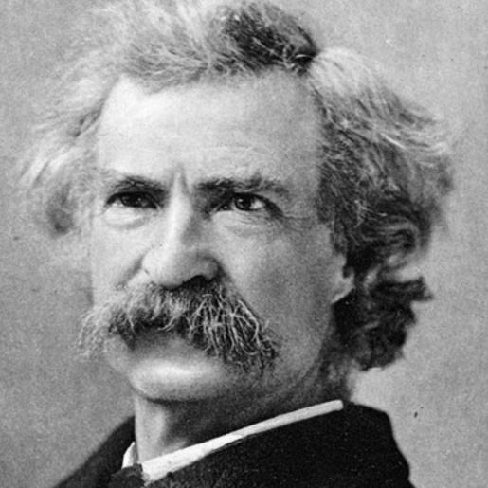
When do we know enough to do something?
I totally know all this
Dunning-Kruger effect
It ain’t what you don’t know that gets you into trouble, it’s what you know for sure that just ain’t so.
Hm, harder than I thought
Very cool, but complicated
Confidence
Beginning to make sense
Impossible!
Knowledge
Mark Twain
Kruger & Dunning (1999) J. Personality Soc. Psych 77, 1121

Slide 49
It takes a (large) village, thank you all
Crestone
Urs Ochsner
Thale Jarvis
John Rohloff
Xicheng Sun
Wendy Ribble
Joshua Day
Cliff Mason
Mary Ann De Groote
Jon Bruss
Hang Liu
Aline Oliver
William Bracken
Teresa Hoang
Lou Boccumini
Katie Johnson
Stacie Bell
Dorothy Colagiovanni
Don Morrissey
NIAID
Seema Nayak
Carol Ostrye
Kenan Gu
Chen Pi
Michael Kozar
Ryan Ranallo
Rick Sciotti
Patricia Gottdiener
Shahida Baqar
Marian Wachtel
Stephanie Zafonte
Blaire Osborn
Mohamed Elsafy
Gabriele Feolo
Richard Gorman
Full support for phase 1 and phase 2 studies
Clinical Support
Jonathan Zenilman
J. McLeod Griffiss
Jeffrey Blumer
Melissa Le
Mary Ann O’Riordan
Wesley Gray
Robin McKenzie
Robert Jurao
Amanada An
Barbara Lomeli
Wael El-Amin
George Saviolakis
Hal Galbraith
Jared Schettler
CDI Advisors
Tom Louie
Mark Wilcox
Jane Freeman
Glenn Tillotson
Mike Corrado
Arizona State University
James Adams
Rosa Krajmalnik-Brown
Phoenix Children's Hospital
Richard Frye
Structural Biology
Doug Davies
Alex Burgin
In memoriam
Sydney Finegold
Replidyne
Ian Critchley
Joe Guiles
Dan Drolet
Jian Qui
Albert Gyorkos
Sarah Strong
Ron Evans
Louis Green
James Bullard
Casey Young
Kimberly Stone
Melissa Price
University of Colorado
Catherine Lozupone

